Slide 1
Cooking with AWS and Splunk
Module 2 : Configure AWS
Kam Amir | Splunk Cloud Architect

Slide 2
Setting up AWS Services
Configuring AWS Services to collect and send data into Splunk
Permissions, Permissions, Permissions – AWS Policy and IAM Roles
Configure AssumeRole feature with IAM User
Configure AssumeRole feature with EC2 Instance
Setup Non-Root AWS Admin Account (with MFA) and a Splunk Access Account
AWS Services
Setup AWS Config
Setup CloudTrail
Setup CloudWatch
Setup CloudWatch Logs
Setup Lambda Functions
Setup Billing CUR
Notes:
In order to get Splunk to work well with AWS, we are going to first start with properly setting up the permissions for Splunk to talk with AWS. Once you have created your root account, you should create two other accounts to access the data stored in AWS. The first account will be your admin account and it will have full access to your AWS console. This account will be used to log into AWS to deploy instances or setup AWS Services. This account should have an MFA (Multi-Factor Authentication) system put into place in order to safe guard your account. Under Splunk management, it will become a ‘chiclet’ in your Okta screen leveraging our two factor authentication with Okta. The second account, will be a programmatic account that allows it to collect data from AWS but it will not have any console access into your AWS deployment. This account is used primarily for Splunk to access your AWS data using a Secret and Access Key. This will be used when setting up your Splunk Cloud Sales Trial.
Finally, we will go ahead and setup the following AWS Services:
- AWS Config – Configuration changes to your aws deployment
- AWS CloudTrail - API Calls within your AWS environment
- CloudWatch – Metrics from your machines such as CPU, Memory and usage metrics for AWS services
- CloudWatch Logs – High volume, logs such as VPC Flow Logs, that allow you to see network / firewall traffic from your deployment
- Finally we will setup Lambda functions to run on-demand code to send data from AWS into Splunk using the HTTP Event Collector (HEC).

Slide 3

What we are going to do:
AWS Config
SNS/S3
SQS Subscription
Splunk SQS based S3 Input
AWS CloudTrail
SNS/S3
SQS Subscription
Splunk SQS based S3 Input
VPCFlow Logs
CloudWatch Logs
Lambda Subscription
Splunk HEC Input

Slide 4
Setting up TWO IAM accounts
After creating your root account, setup an admin and SplunkAccess Account
There will be two IAM User Accounts created in your account.
The first account will be your AWS Admin account used to log into the AWS console.
The second account will be the SplunkAccess Account which will be used to collect data from your AWS account.

Slide 5
Create Admin Account
This account should be protected with MFA once you have finished adding the user

Slide 6
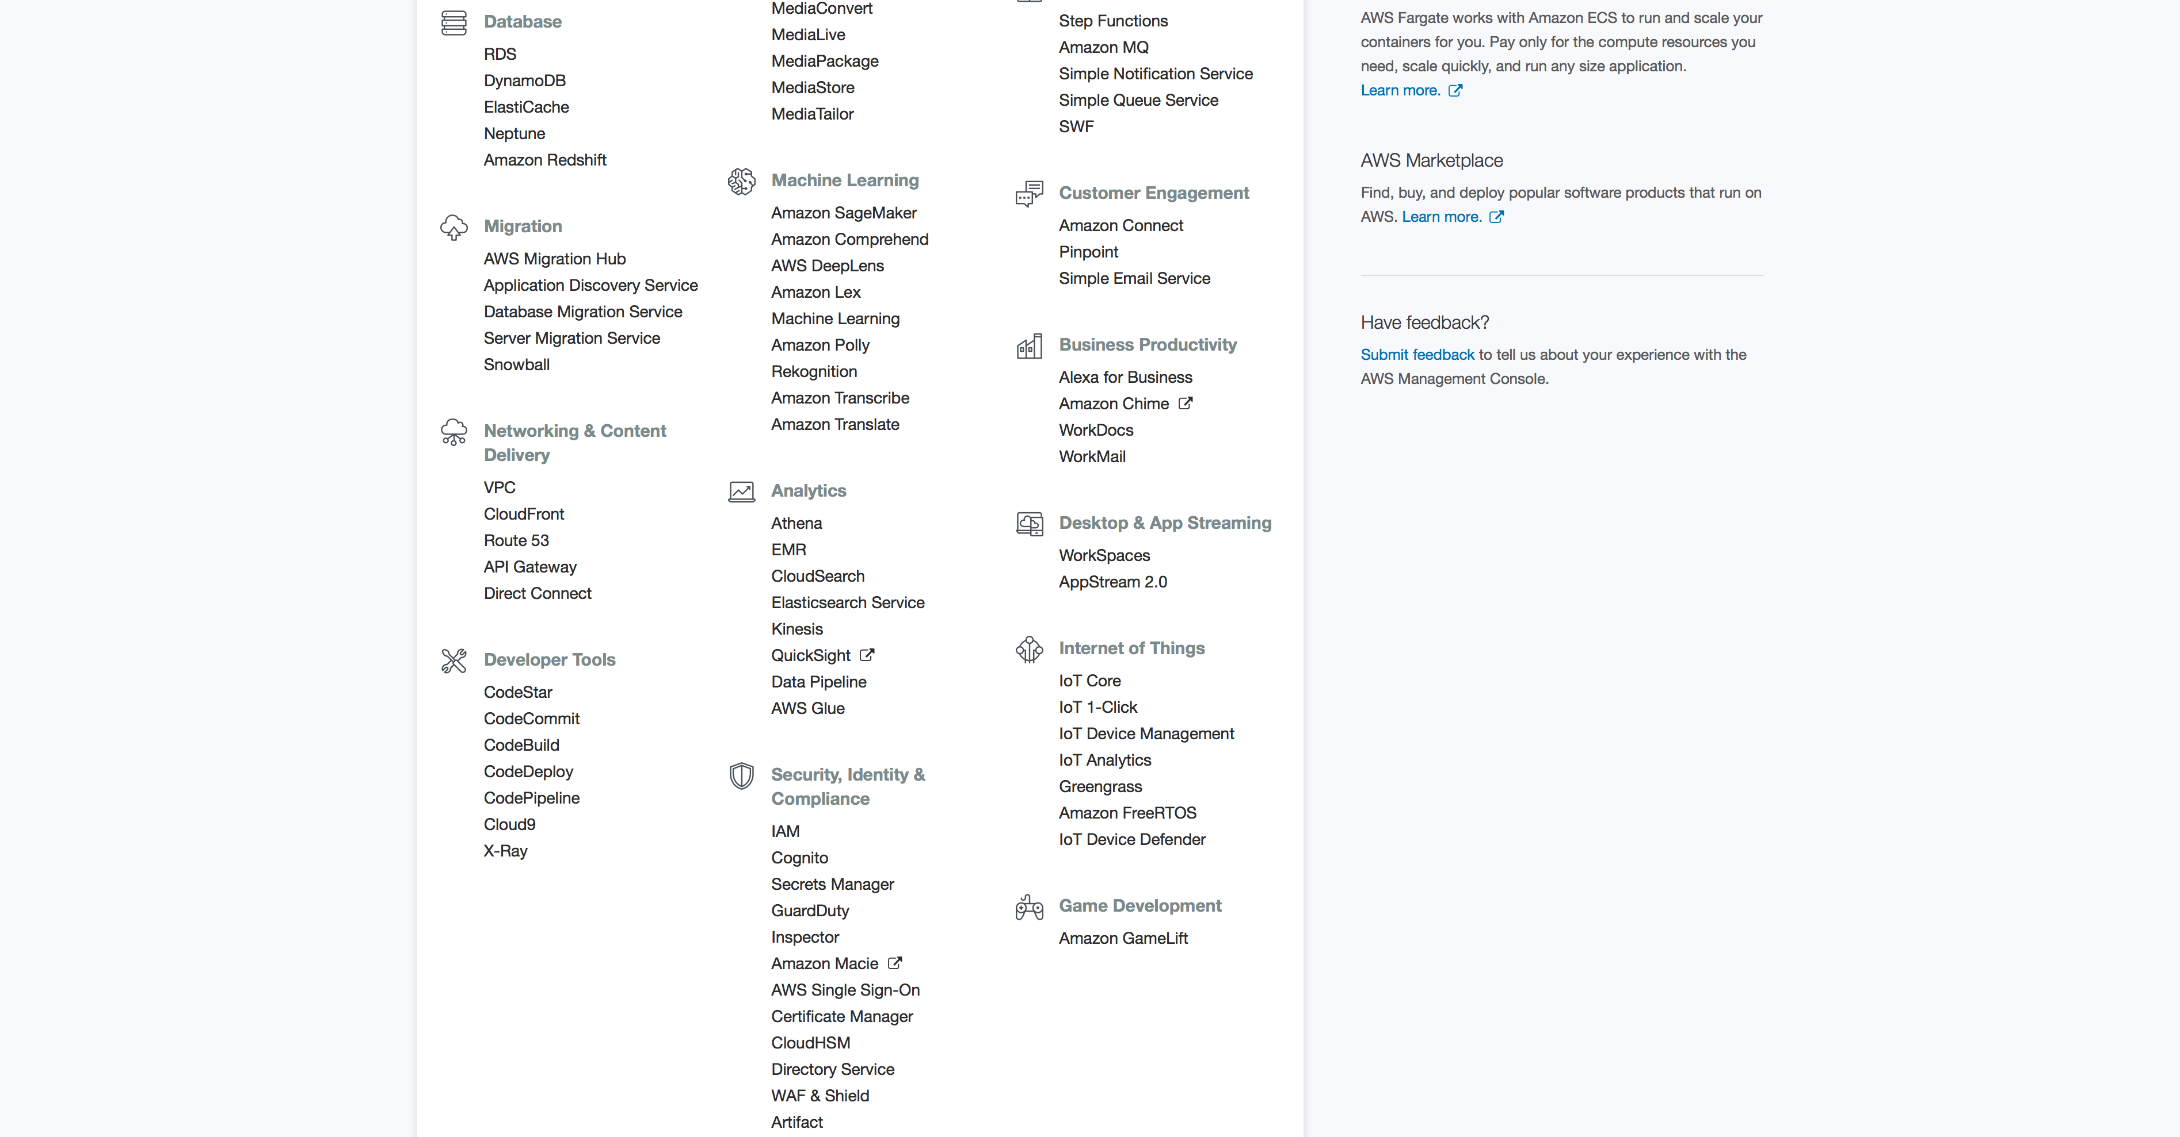
IAM Roles, Users
Security, Identity & Compliance -> IAM
Click Here
Notes:
Let’s start by opening IAM and click on the Users menu from the left hand side.

Slide 7
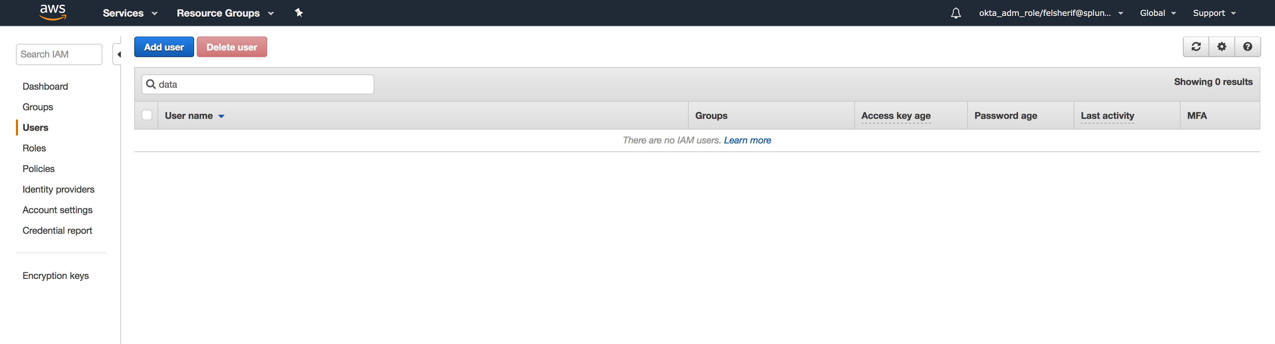
Create New Admin Account
Click Add User
Notes:
Now that we are in the users menu, click on “Add user.”

Slide 8
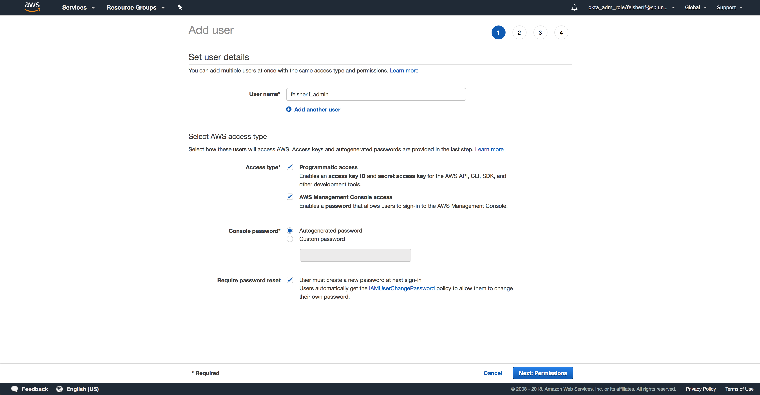
Create User Name
Enable Access Type, create password
Notes:
Give your new user a name, I suggest using your NT Username followed by “_admin” so you know it’s your admin account. Grant it Programatic and AWS Management Console Access. Feel free to either create a password or have AWS generate one for you. Now click on Next: Permissions.

Slide 9
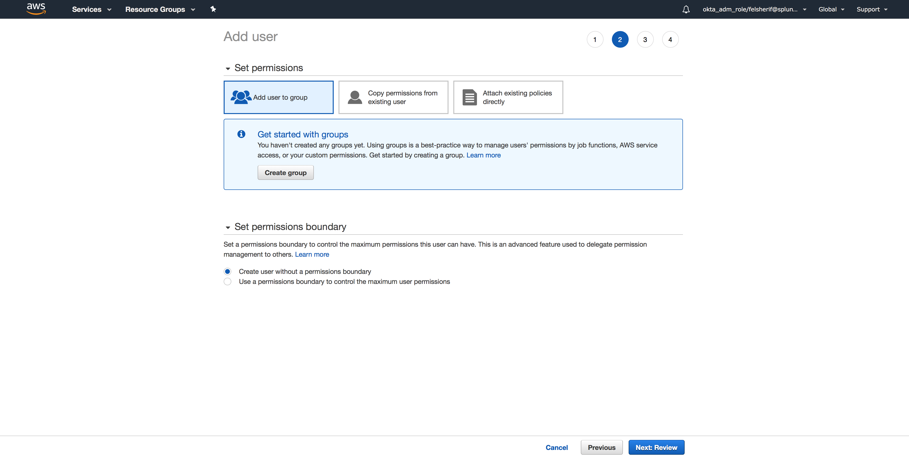
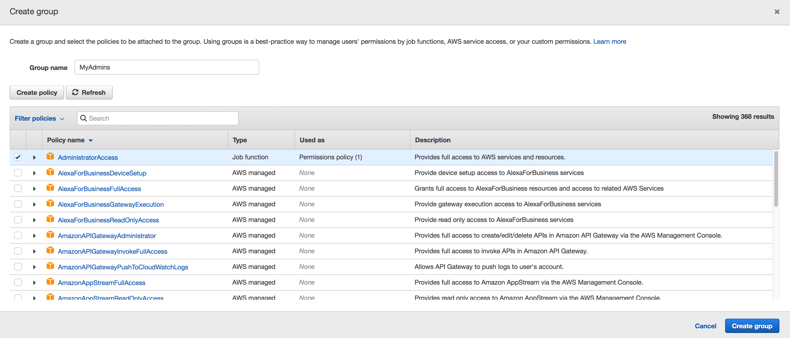
Set Permissions
Create a new group if first time creating accounts
Create full Admin Access
Scroll Down, click review
Notes:
You will now need to create a group and grant that group access via a Policy for your user. Start by clicking “Create group,” search for “AdministratorAccess” and click on the checkbox to the left. Give the group a name and click “Create Group.” Once the group has been created, scroll down and click “Review.”

Slide 10
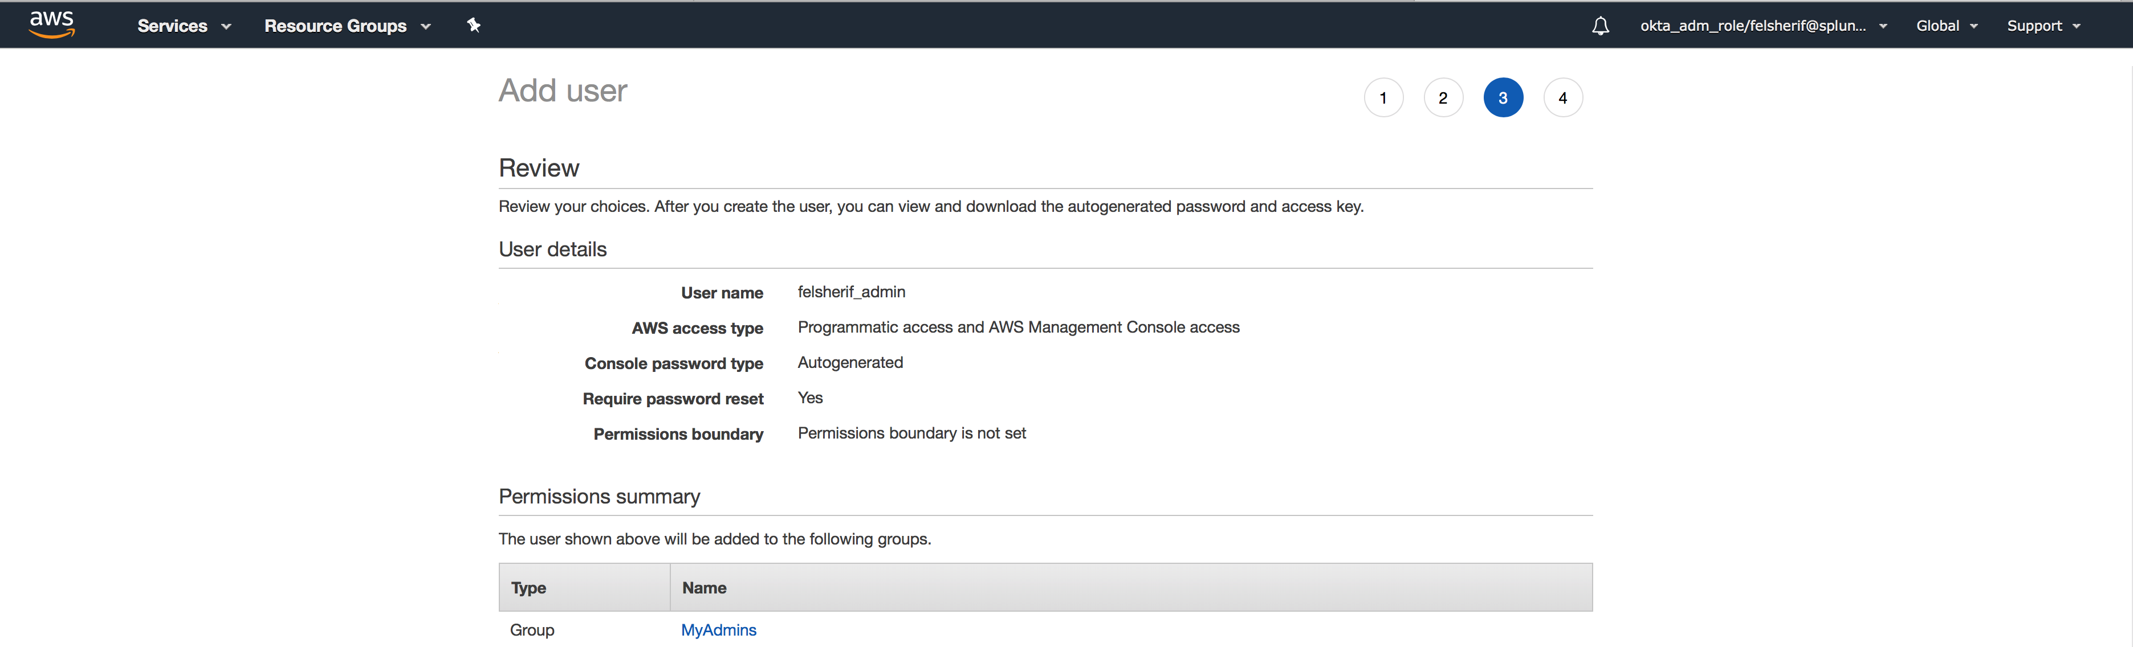
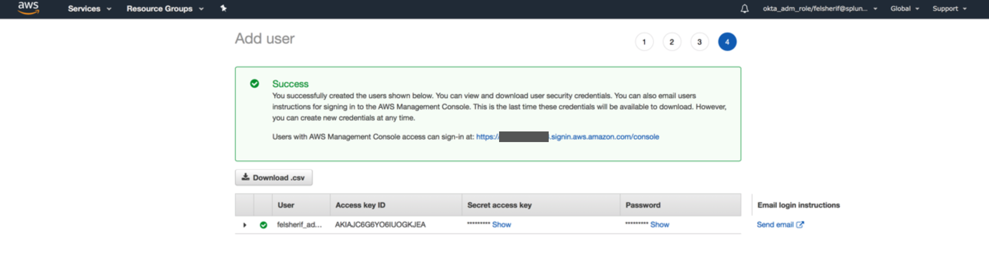
Create User, download keys
Make sure to download Access Keys and SAVE THEM
Notes:
If everything looks good, go ahead and click “Create user.” Make sure that you download your credentials.csv file and have them somewhere that you will remember where they are. You cannot recover the access key, the only thing you can do if you forget it is to re-deploy a new set of keys (Secret and Access.)

Slide 11
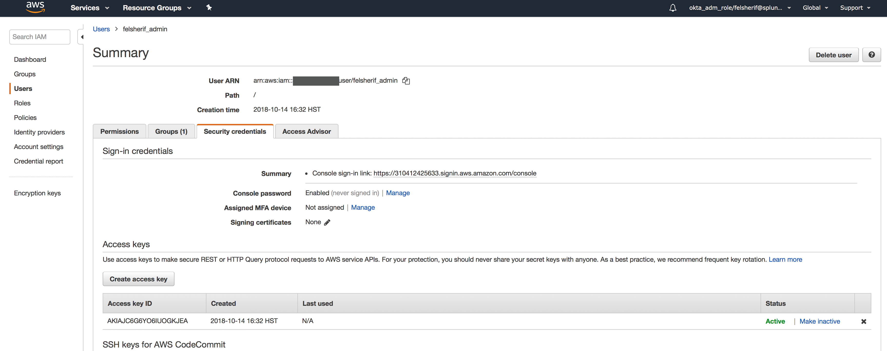
Enable MFA
Click on the username and go to Security Credentials Tab
Click Here
Notes:
Finally, make sure that you enable the MFA for your admin account. Go back to your user account you just created, click on it and click on the ”Security credentials” tab. Click on the edit button by the Assigned MFA device and enable it.

Slide 12
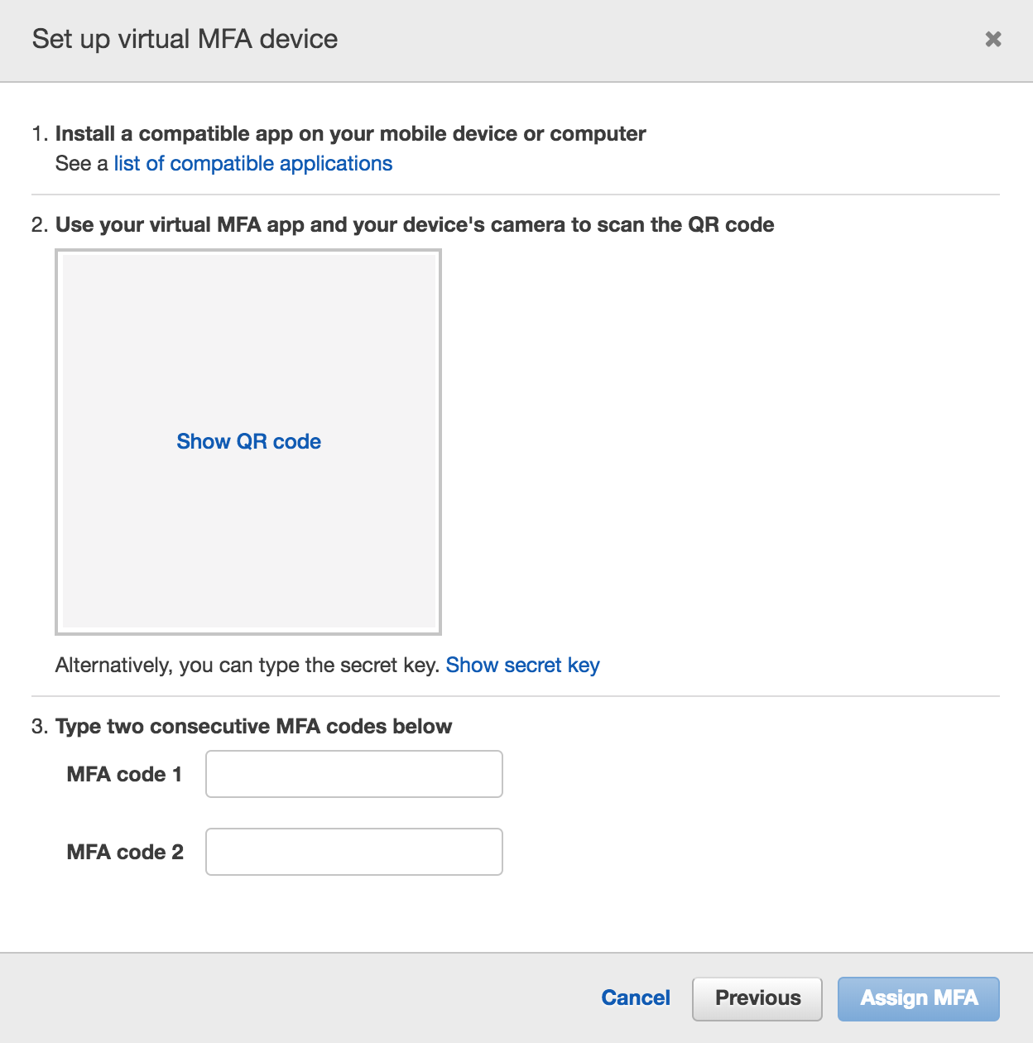
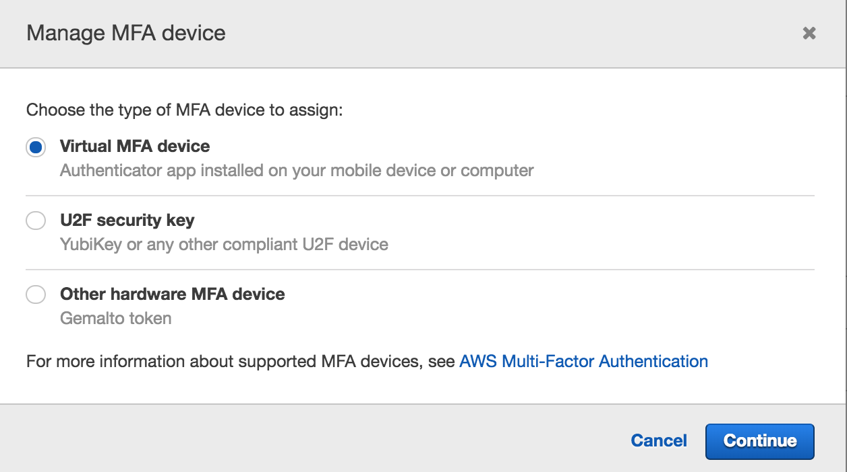
Create Virtual MFA
Use Google Authenticator, enter in Codes twice
Notes:
Select “Virtual MFA Device” and then scan the QR code in the next screen. I would recommend that you have Google Authenticator for your MFA device. Once you scan it with your phone, the codes should start to appear. Type in the first code in the Authentication Code 1 box, then wait for it to time out. Once it’s timed out, a second set of numbers should appear, put those into the Authentication Code 2 box and then click Activate Virtual MFA.

Slide 13
Create Splunk Policy for AWS
Use the documentation to add the SplunkAccess Policy to your AWS account

Slide 14
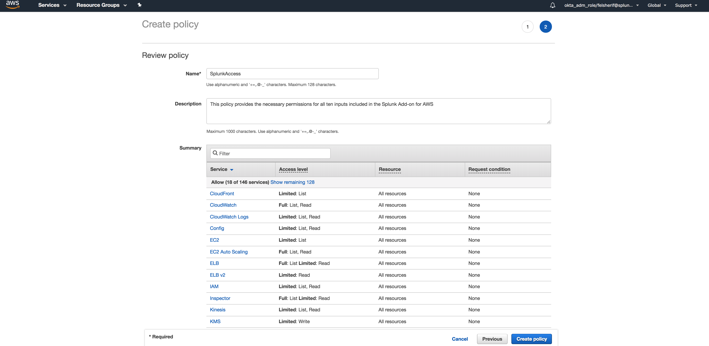
Create IAM Policy Overview
Create SplunkAccess Policy based on documentation
Get AWS Policy from Splunk Doc Website
http://docs.splunk.com/Documentation/AddOns/released/AWS/ConfigureAWSpermissions
Select “Configure one policy containing permissions for all inputs”
Open IAM -> Policies -> Create New Policy
Create New Policy
Paste the Policy
Notes:
Here is an overview of what will be done to setup the Splunk Policy that will be used to collect data from AWS. First, go to the document link listed above and scroll down to the “Configure one policy containing permissions for all inputs.” Copy that policy (JSON) and then go back to your AWS console. Open IAM, select Policies from the left hand menu and click Create New Policy. In the policy screen, select “Create Your Own Policy.” Give your policy a name, like SplunkAccess, then a brief description and finally paste the policy in the last box. Validate the policy to make sure it was copied properly, then click on Create Policy.

Slide 15
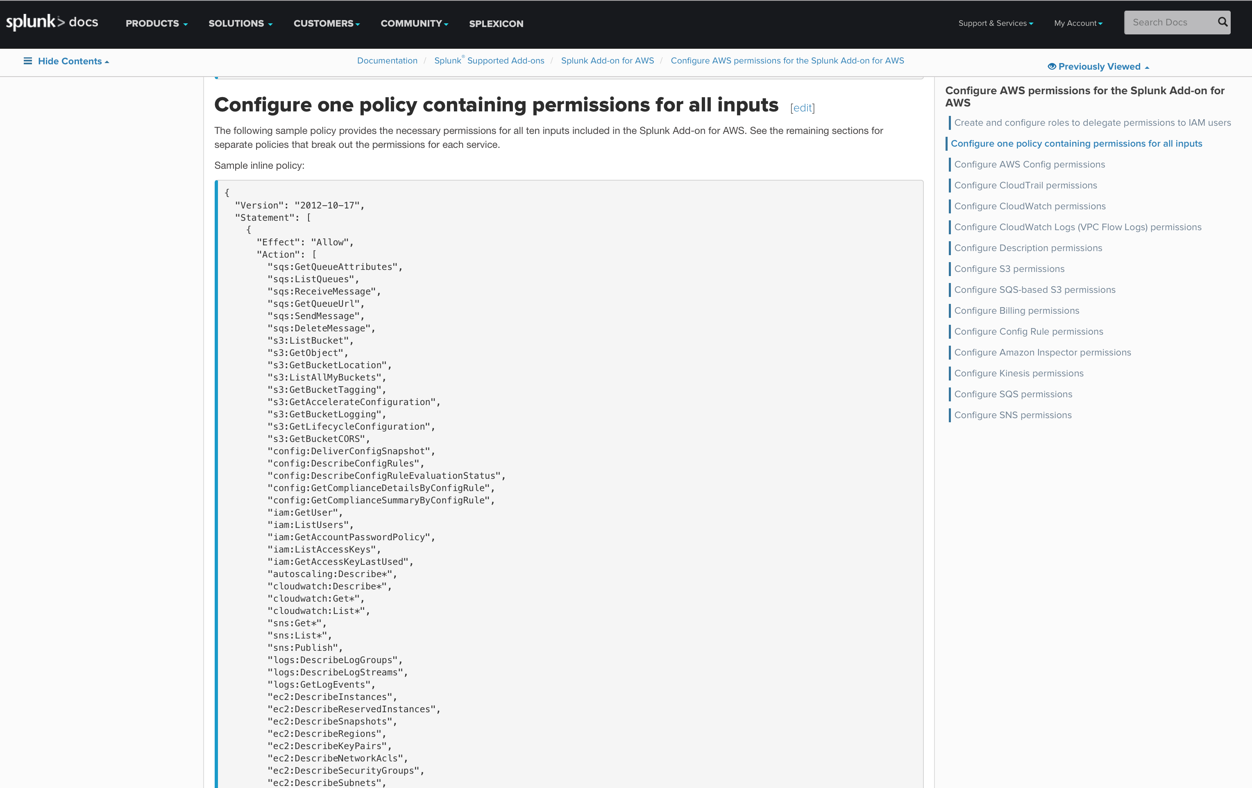
Copy Policy from Docs Page
Open Docs Page:
http://docs.splunk.com/Documentation/AddOns/released/AWS/ConfigureAWSpermissions

Slide 16
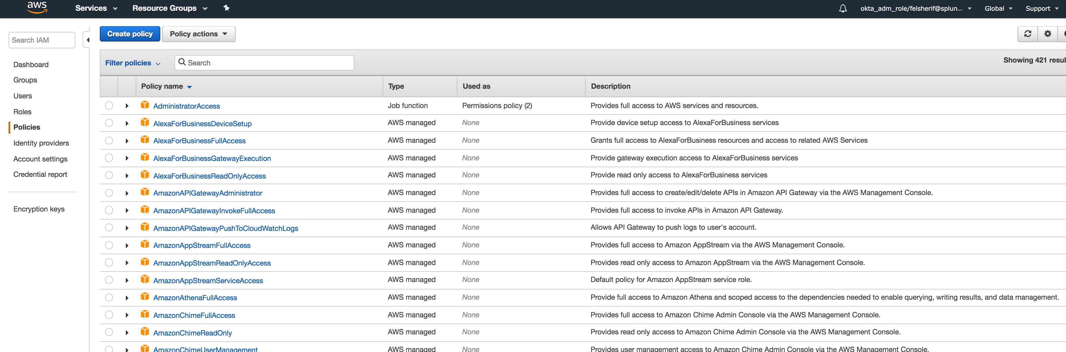
Create the AWS Policy (1/3)
Under IAM -> Policies -> Create Policy
Click Here

Slide 17
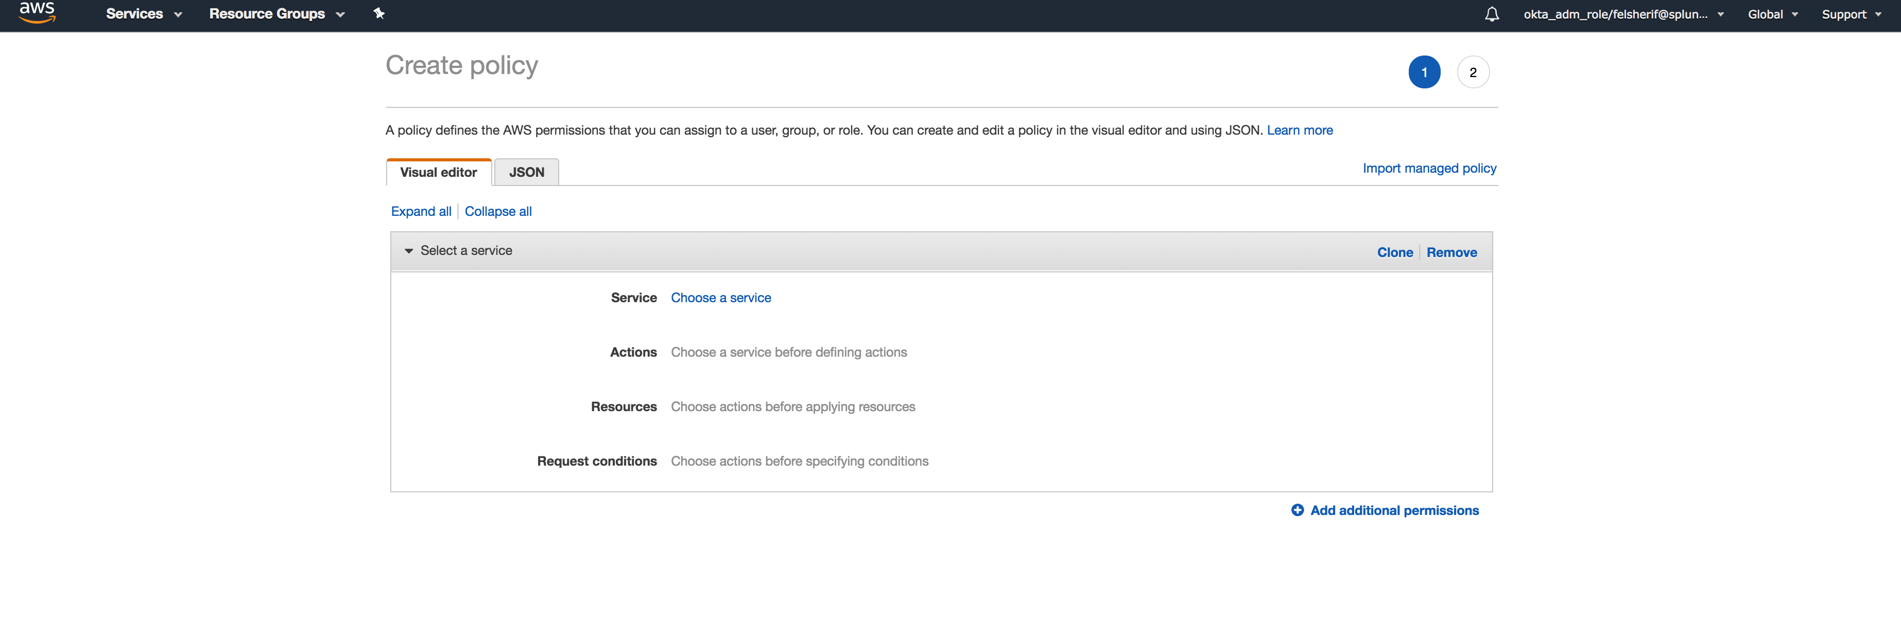
Create the AWS Policy (2/3)
Under IAM -> Policies -> Create Policy
Click Here

Slide 18
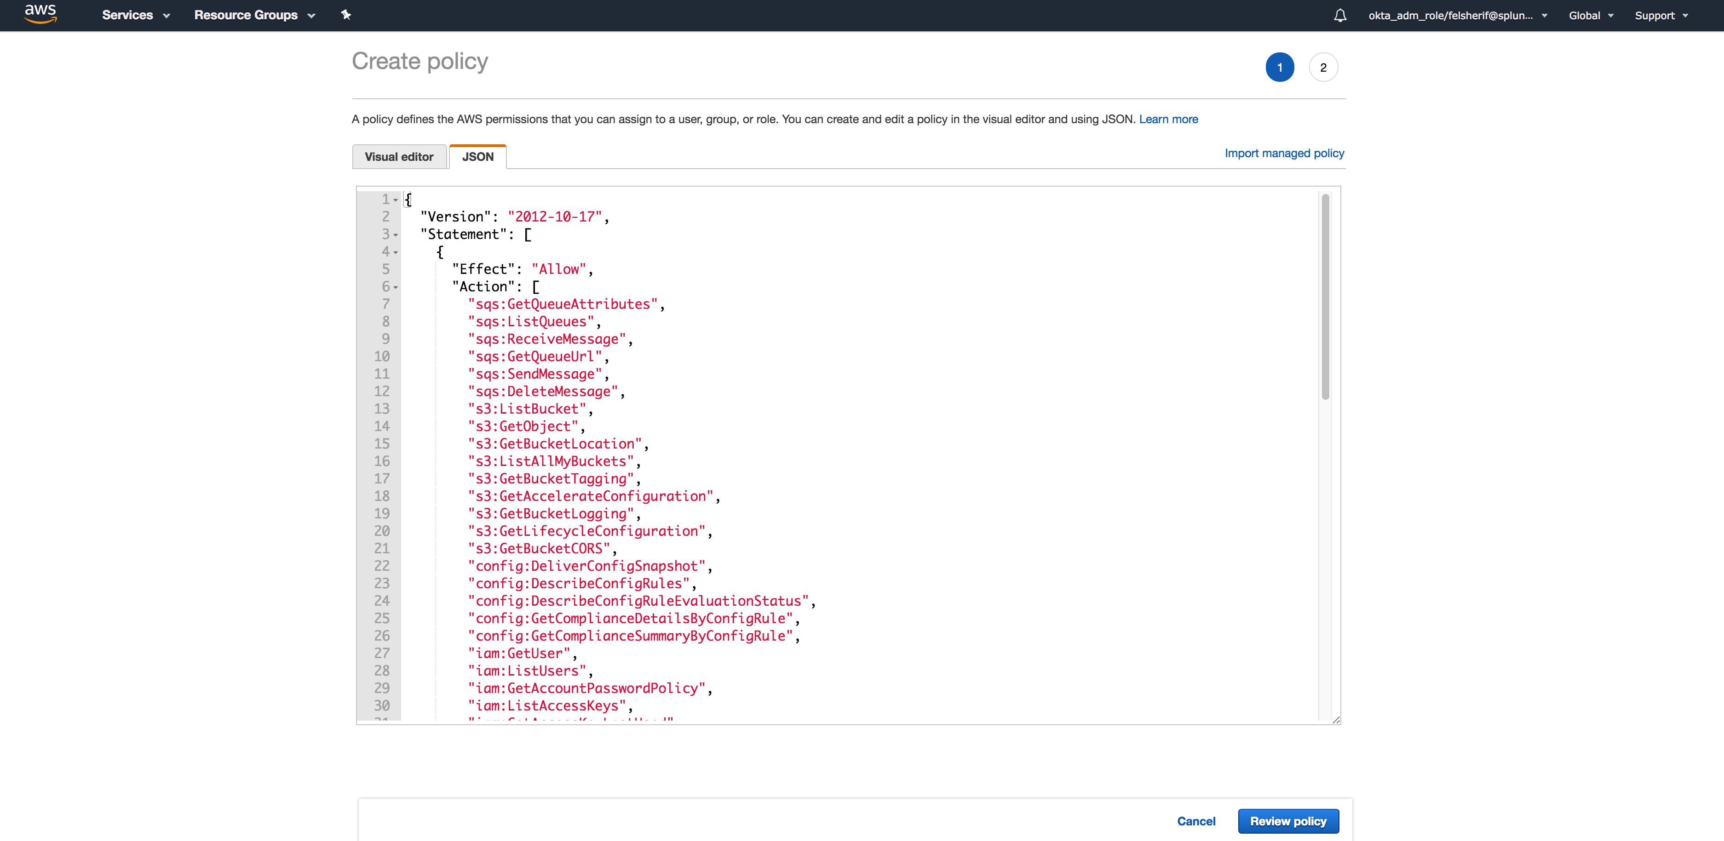
Create the AWS Policy (2/3)
Under IAM -> Policies -> Create Policy
Paste the policy from the docs.splunk.com website.
Click Review Policy

Slide 19
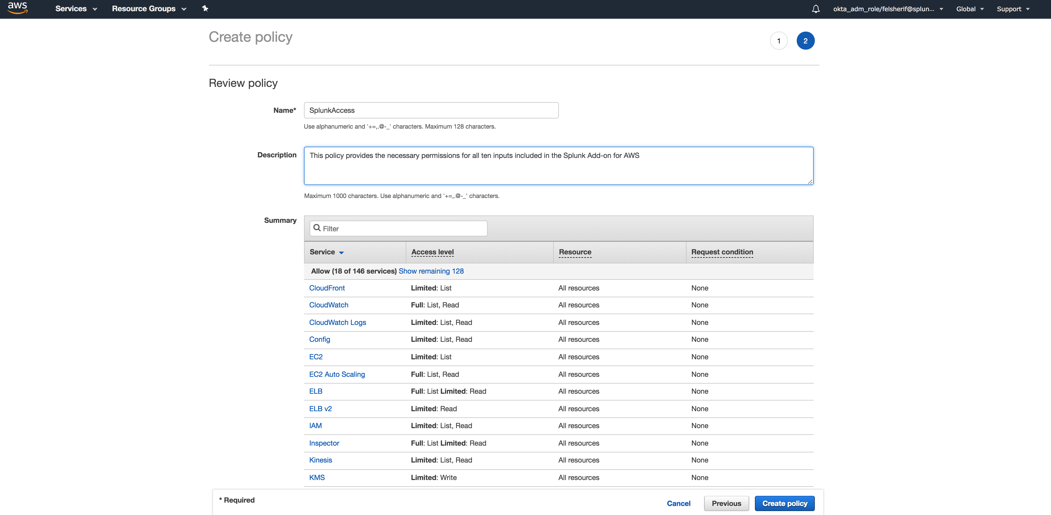
Create the AWS Policy (2/3)
Under IAM -> Policies -> Create Policy
Name the Policy SplunkAccess.
Give it a description.
Click Create Policy

Slide 20
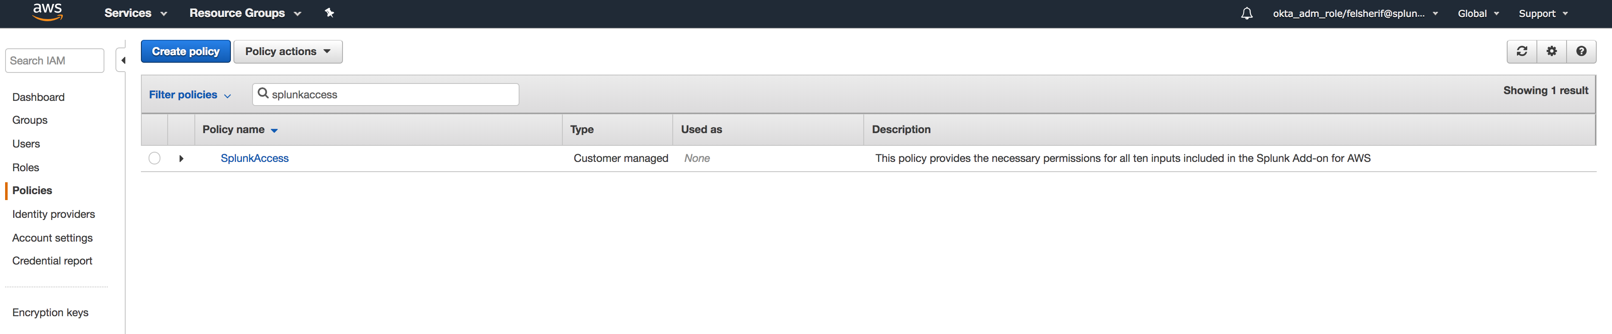
Create the AWS Policy (3/3)
Validate the Policy

Slide 21
Add SplunkAccess User
This user will only have programmatic access to your AWS deployment

Slide 22
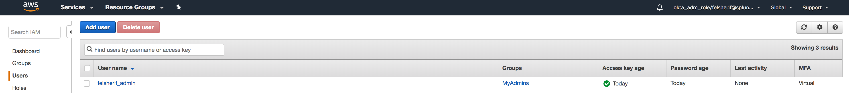
Create Splunk Access Account
Create programmatic account called SplunkAccess
After adding your admin account, click on Add User
Notes:
Let’s start by opening the IAM -> Users list and click on Add User.

Slide 23
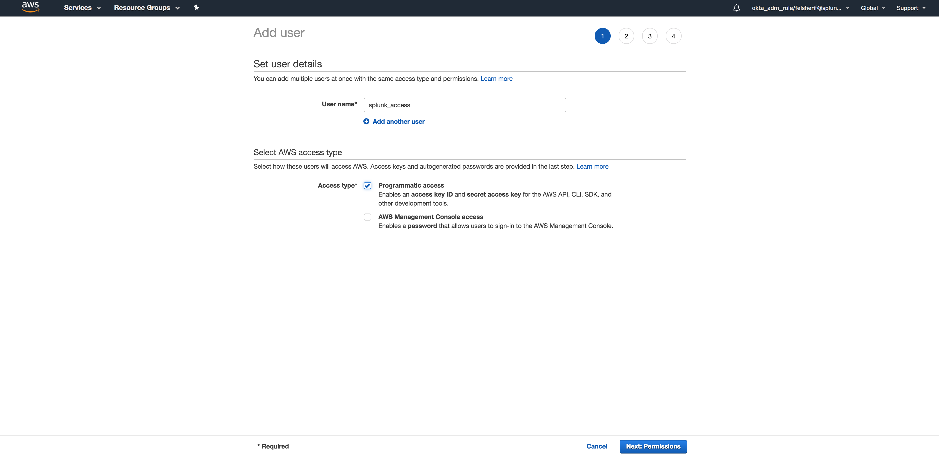
Add splunk_access User
Grant the user Programmatic access only
Check this only
Notes:
This user will only be granted “Programmatic access,” NOT Console Access. This is a way to safeguard that if this account becomes compromised it will not have the ability to log into your aws deployment.

Slide 24
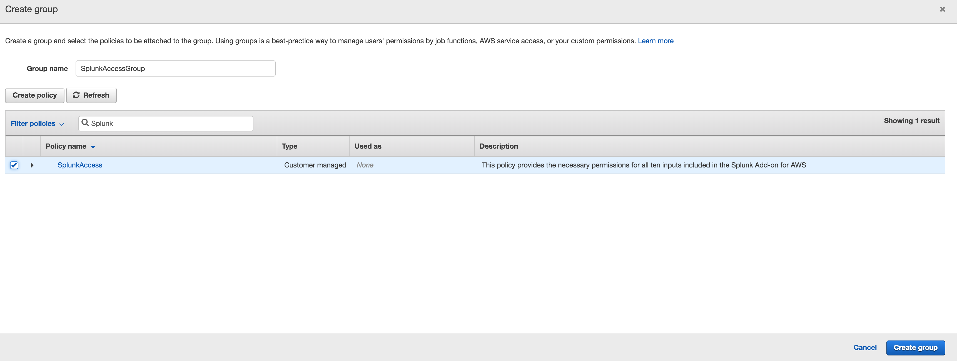
Create new Group SplunkAccessGroup
Attach newly created SplunkAccess Policy
Search for “Splunk”
Select the Policy
Notes:
Here you will create a new group, call it SplunkAccessGroup, and we will attach the policy we just created in the previous step. To find the policy, search for SplunkAccess and it should be displayed in the menu below. Click on the checkbox by the name, then click on “Create Group.”

Slide 25
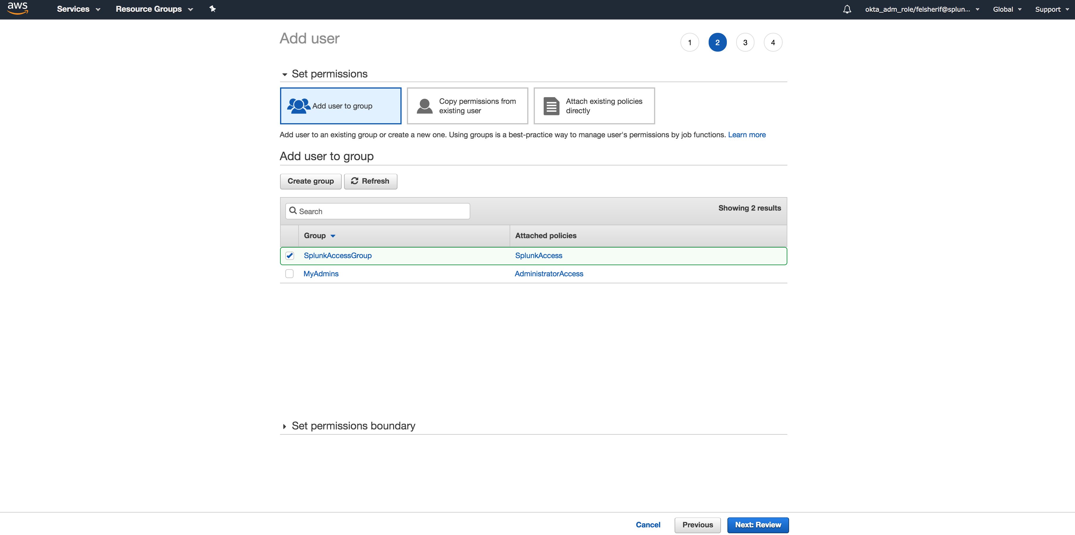
Review Newly Created User
Notes:
Once the group has been created, select it and scroll down and click “Next: Review.”

Slide 26
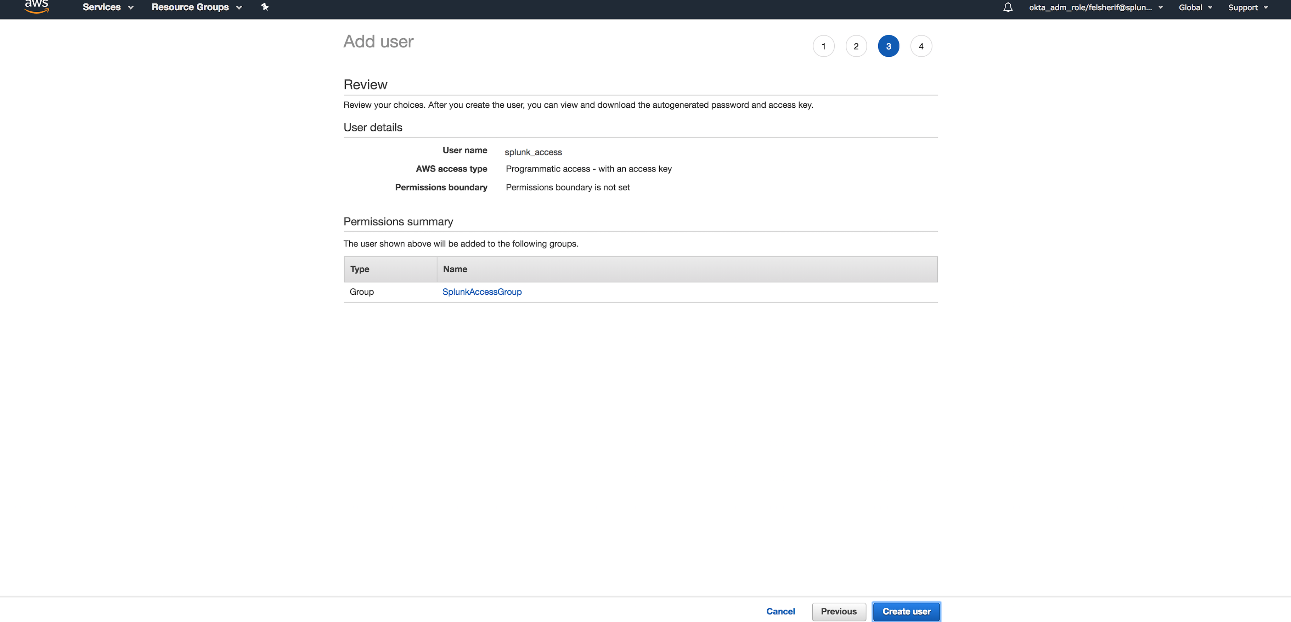
Create User
Notes:
If everything looks good, click on “Create user.”

Slide 27
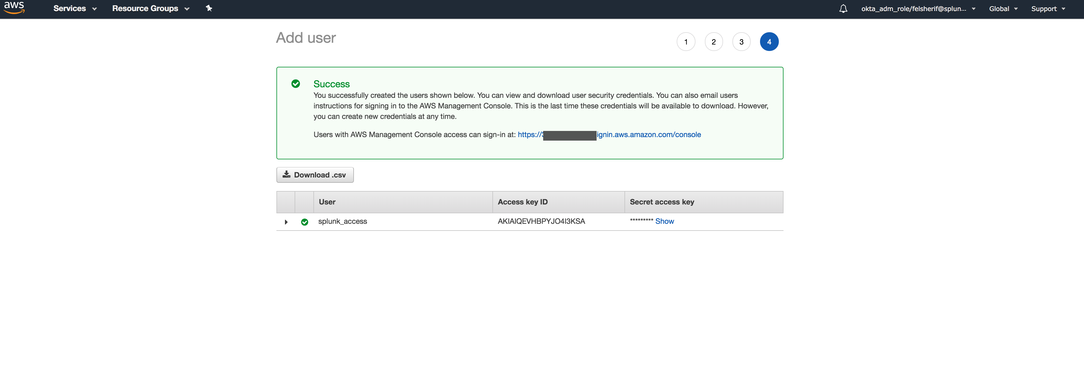
Download Credentials
Download credentials for newly created user
Notes:
Again, don’t forget to download the credentials.csv file for your newly created user.

Slide 28
Create EC2 Role
EC2 Roles allow machines to assume roles with policies to access data on AWS
Notes:
In this section we will create an EC2 role that will leverage the SplunkAccess Policy created in the previous section.

Slide 29
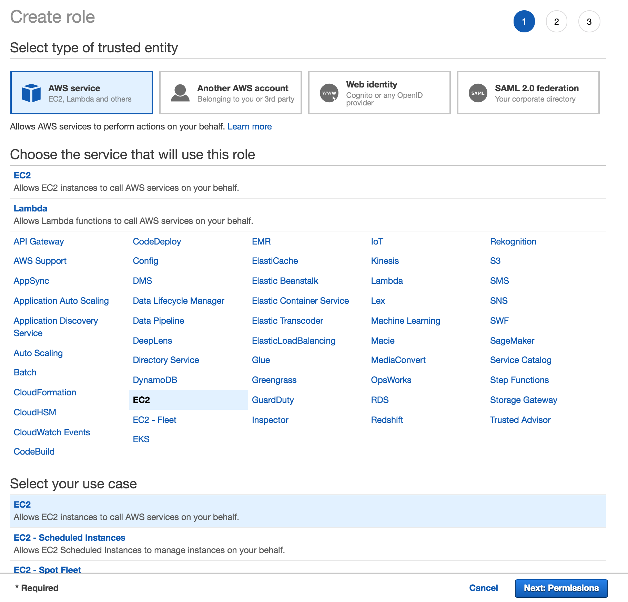
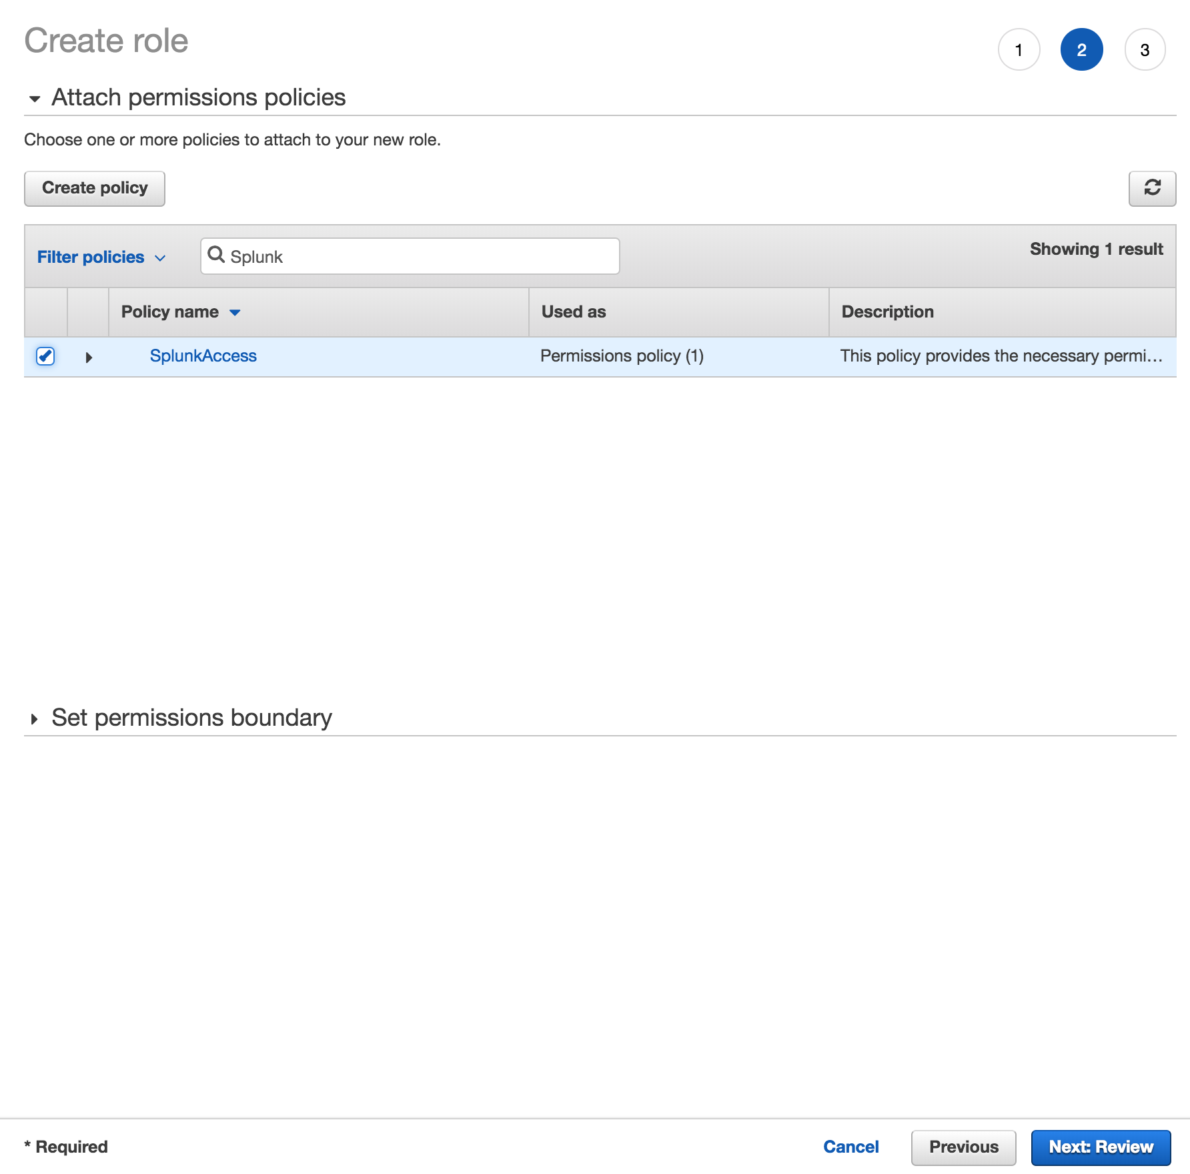
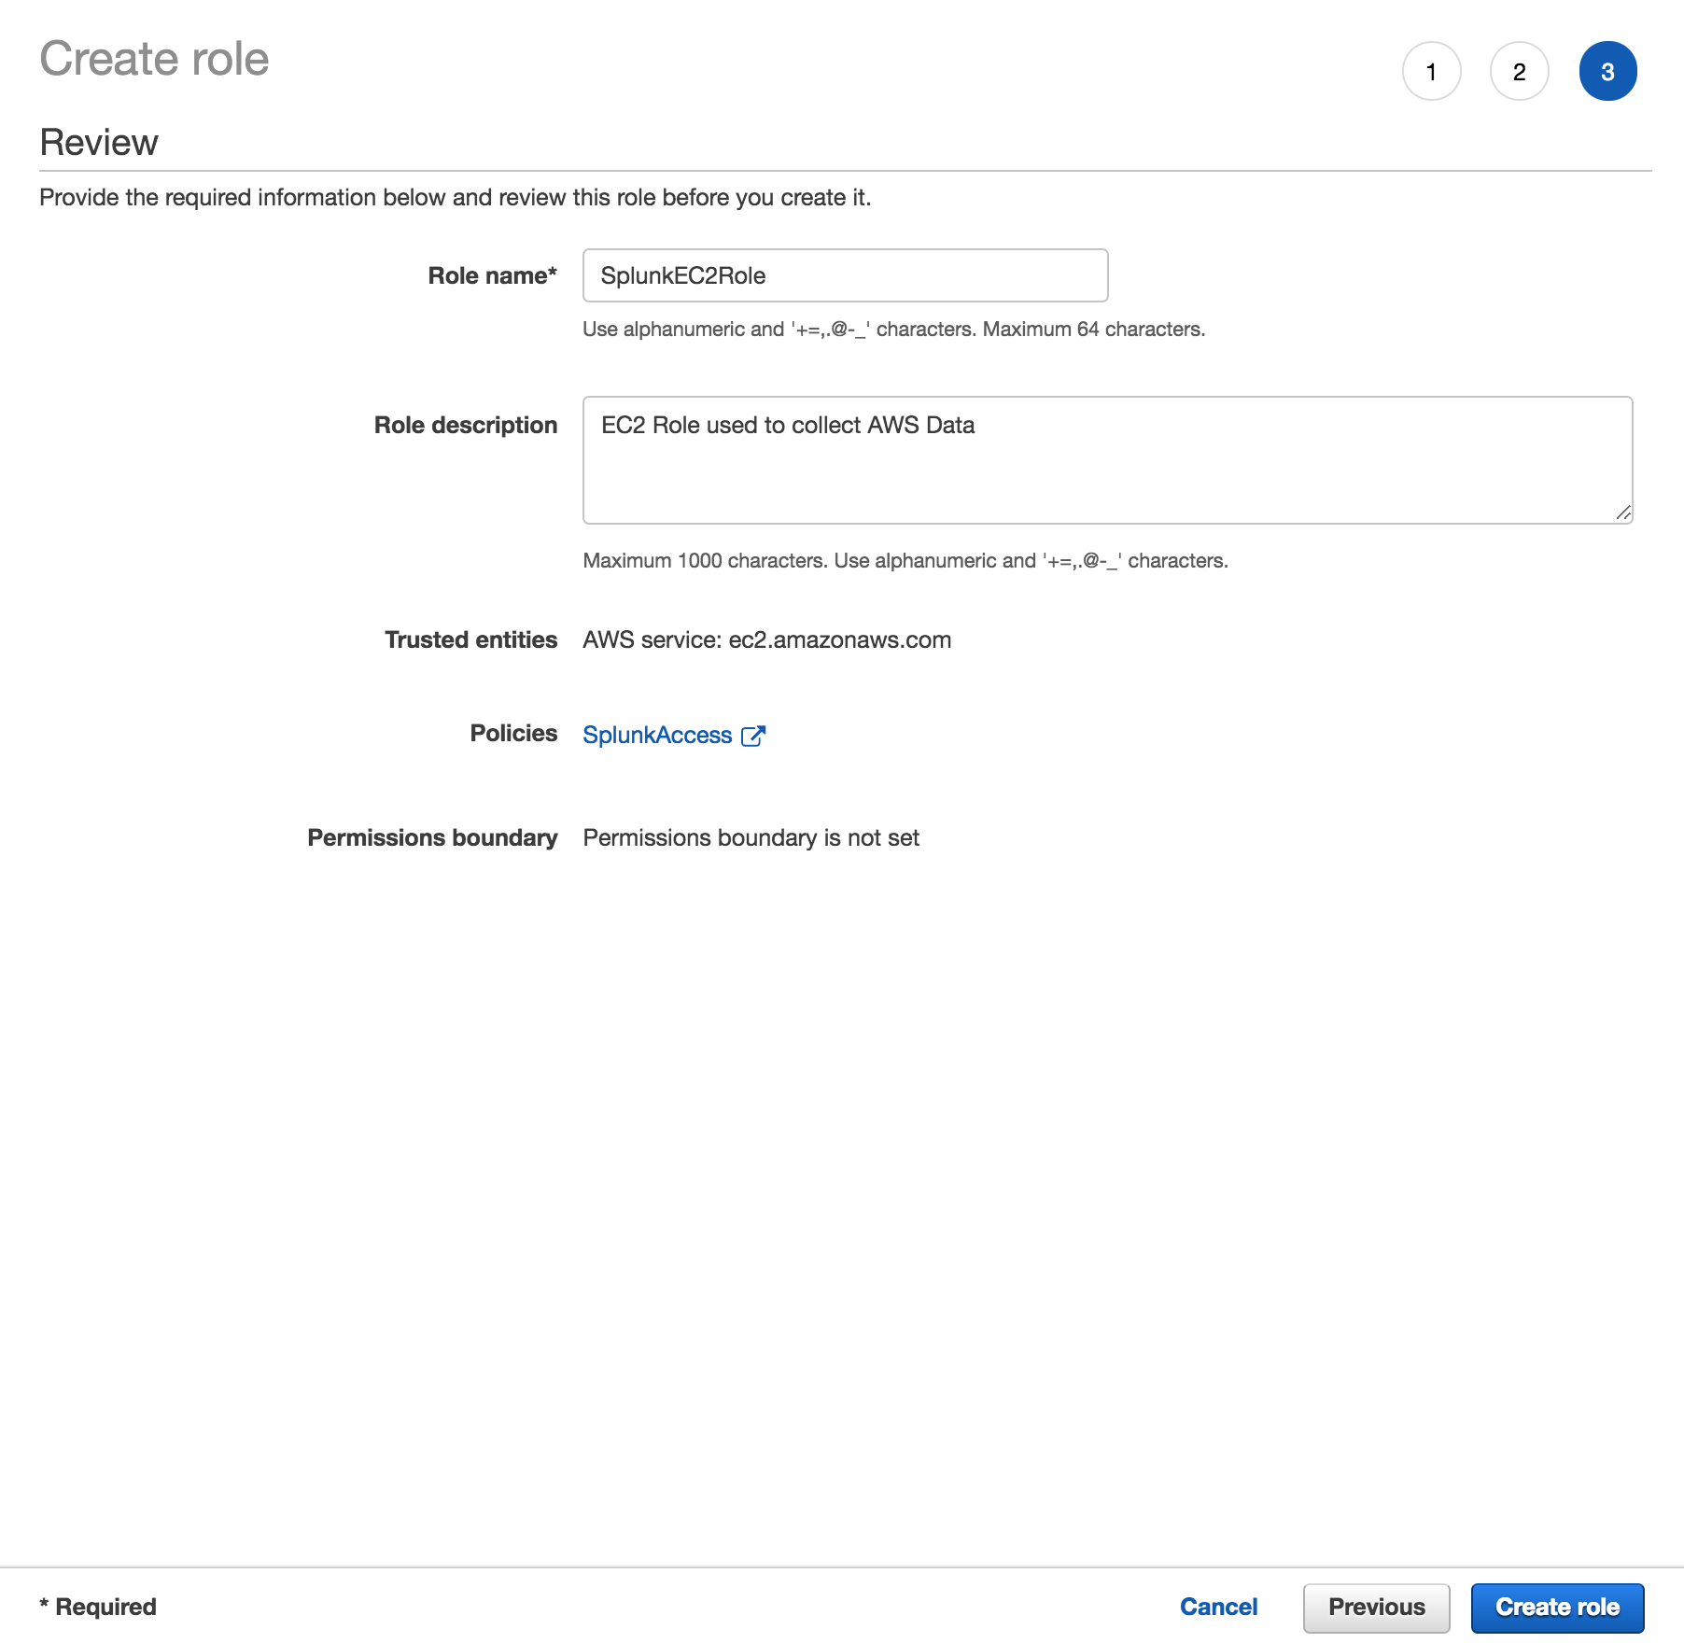
EC2 Role Overview
Open IAM -> Select Roles -> Create Role then…
Role Type AWS Service -> Select EC2 -> Use Case EC2
Attach SplunkAccess Policy
Call the Role “SplunkEC2Role” and click Create Role
Notes:
First start by going into your IAM screen, select “Roles” from the left hand menu and click “Create role.” Under the Services, select EC2 and at the bottom select “Use Case EC2.” Attach the “SplunkAccess” policy, by searching for SplunkAccess and select the checkbox by the name. Don’t click on the policy name, it will take you to the editor for the policy. Once the policy has been selected and attached, then give your new role a name like “SplunkEC2Role,” and click ”Create role.”

Slide 30
IAM AssumeRole For multiple sub-accounts
Grant a primary AWS account access to collect data from multiple sub-accounts.
Notes:
This scenario is relevant when a customer has multiple sub-accounts and would like to use a primary account to collect the data from the sub-accounts. First, the sub-accounts will establish a role that has a trust relationship in place with the primary account. Then, the IAM user in the primary account will be added to the role which is trusted by the sub-accounts. In the Add-On, using the AssumRole feature, the account will be able to collect data from the sub-accounts.

Slide 31
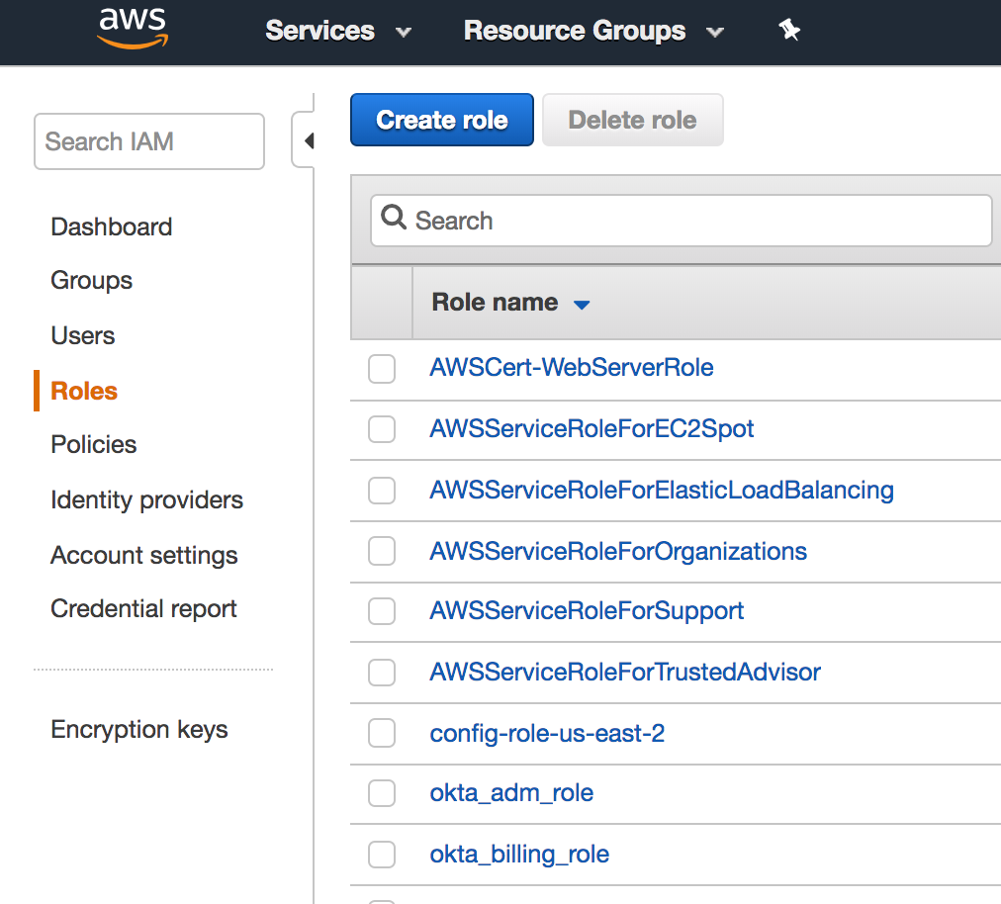
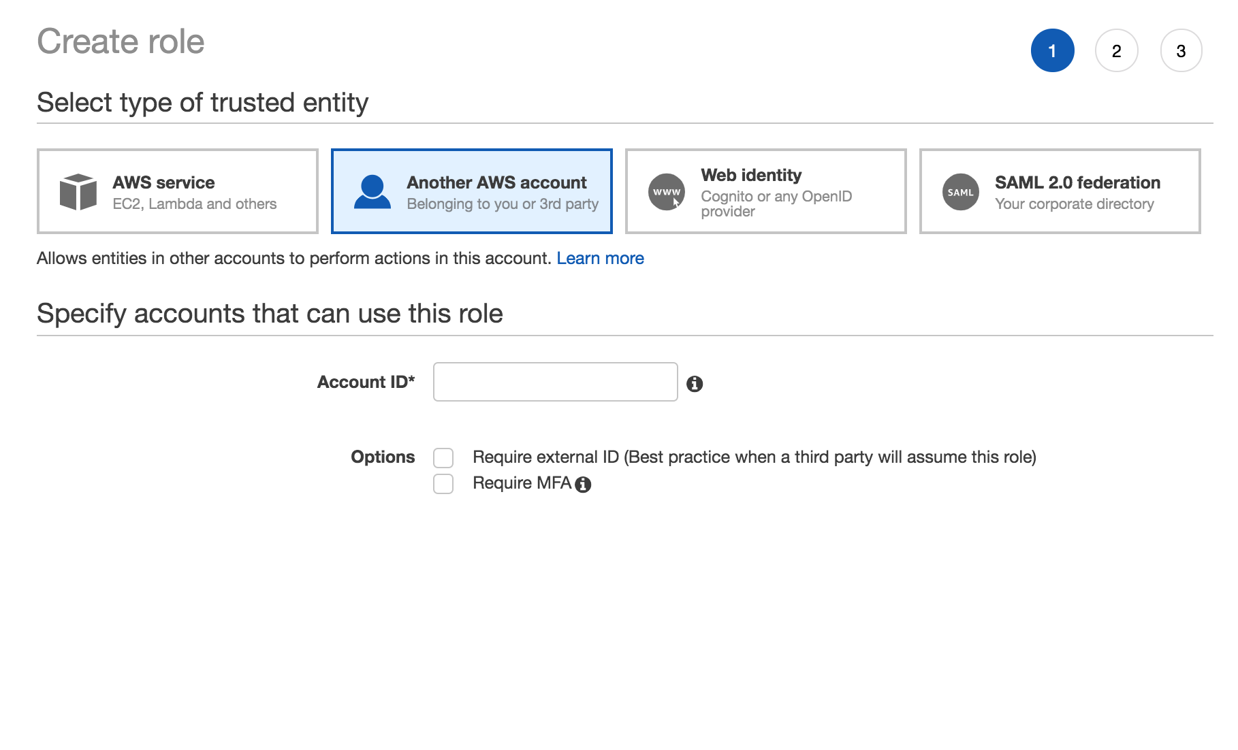
Create Cross Account Role in Sub-Account
Click here
Click here
Enter primary AWS account here
Notes:
The process to setup a master account with access across multiple sub-accounts is done under the IAM Roles and establishing a trust relationship. First in the sub-account, open IAM and navigate to the Roles section.
Under Account ID* enter in the Primary AWS account that will be ACCESSING this sub-account and leave the two options unchecked. Click Next: Permissions

Slide 32
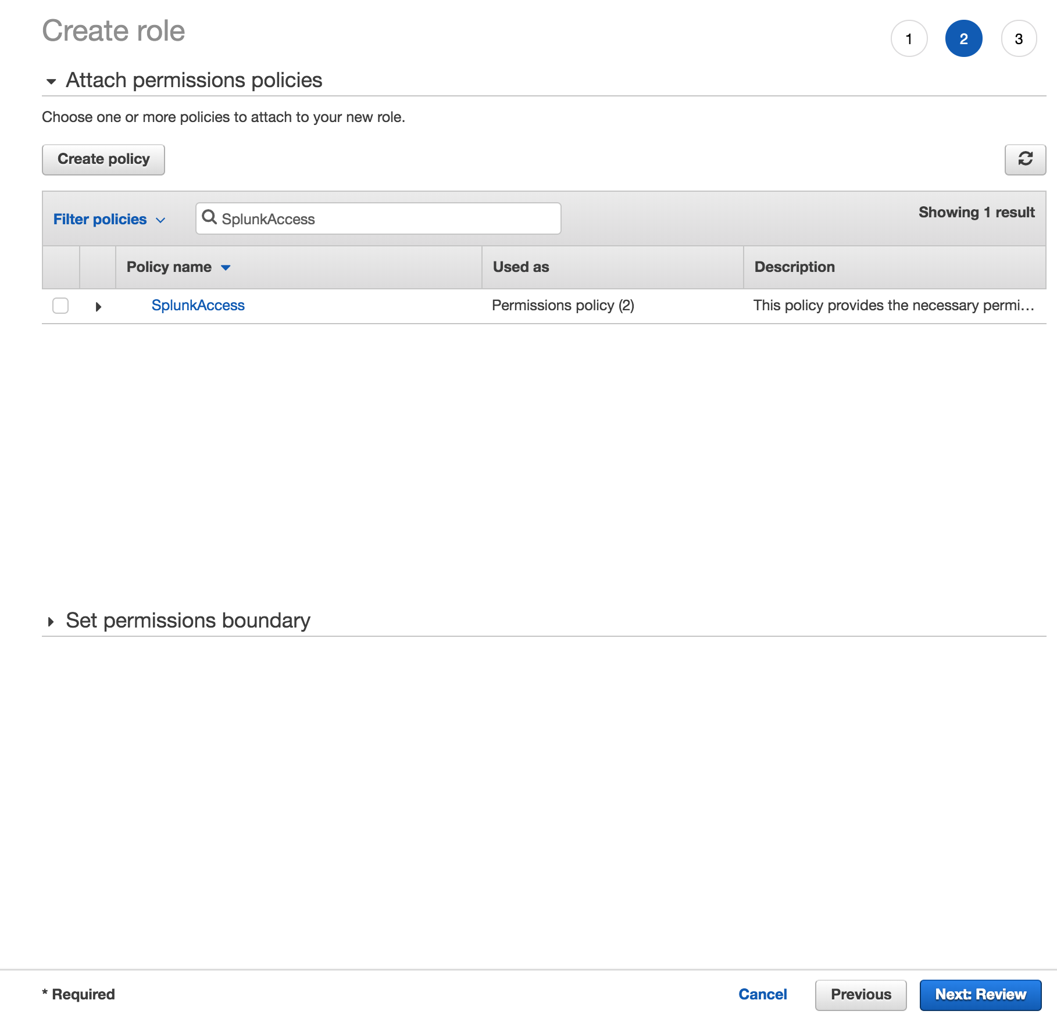
Assign the SplunkAccess policy
Notes:
Assuming you have already create the Splunk Access policy in this account, simply find it and attach it to this role, then click Next:Review:

Slide 33
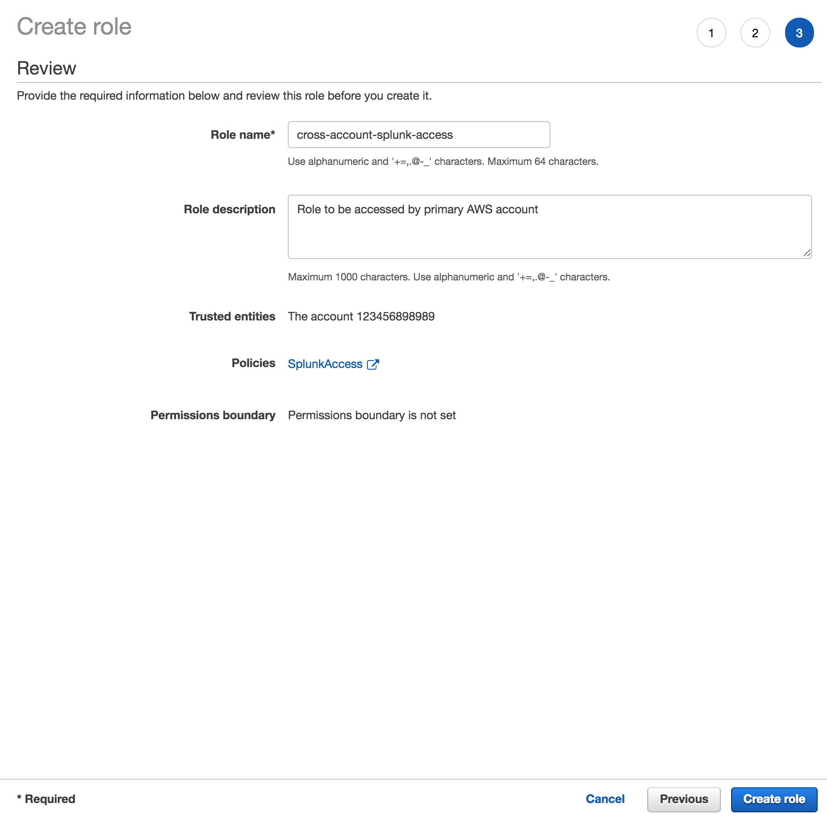
Name the Role and Create it
Notes:
Give this new role a name and a short description, then click Create role:

Slide 34
When to use IAM User, AssumeRole and EC2 Role
Here is an explanation about the different ways to setup permission to your AWS stack with Splunk.
Notes:
Here we will explain when to use the IAM Access user, the AssumeRole feature or the EC2 role.

Slide 35
AWS IAM Permissions Explained
Define AWS Policy
Copy Sample Policy
Generate Policy
Assign Policy to Role
AssumeRole
IAM Role
EC2 Instance
Policy
OR
Notes:
Policy are the rules that AWS grants to the users, roles or EC2 instances to access services within AWS. Roles are controls which are used by AWS to access services. The AssumeRole feature allows Users or EC2 instances to assume the role with a policy, such as collecting data from AWS to Splunk, without having to give them credentials to do so.

Slide 36
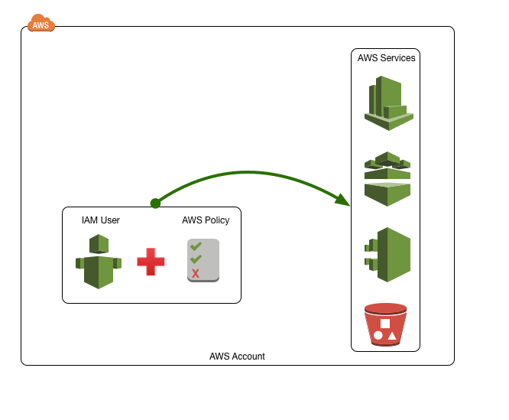
Connect Directly with IAM User
Smaller organizations leverage Users with Policy’s to access Services
Small AWS deployment and no restraints on IAM user access
Used for testing purposes
Single User connecting to AWS Deployment
No access to Splunk Deployment (Splunk Cloud, Splunk Cloud Sales Trial)
Notes:
When you customers first start with AWS, they will use a single user with an attached policy to connect to the appropriate AWS Services. This is very typical for initial use cases where there are little controls in place or when the user does not have direct access to the EC2 instance. While this is good for small use cases, it’s not the best practice for larger scale deployments.

Slide 37
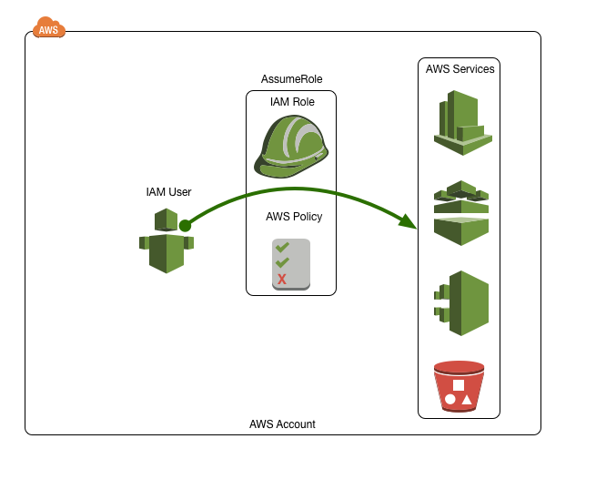
AssumeRole with IAM User
Organizations with segmented staff will leverage AssumeRole
Typically larger deployment with tighter user access / control.
Used to limit users / roles to specific AWS Resources
RBAC Controls / AD linked accounts
No access to Splunk Deployment (Splunk Cloud, Splunk Cloud Sales Trial)
Use AssumeRole to connect to other accounts to collet the data from these accounts
Notes:
Mature customers have instituted the “AssumeRole” feature in AWS where users do not have access to the AWS Services, but are granted access to Assume the Role of a role that the properly associated policy which grants them access to collect data from AWS. This system is useful for more restrictive environments where IAM users do not have direct access to the AWS resources. Splunk supports the ability to AssumeRole in the TA and is documented in the docs page listed in the policy screen. This step requires that the role has a Trust Relationship enabled with the IAM user trying to Assume the role.

Slide 38
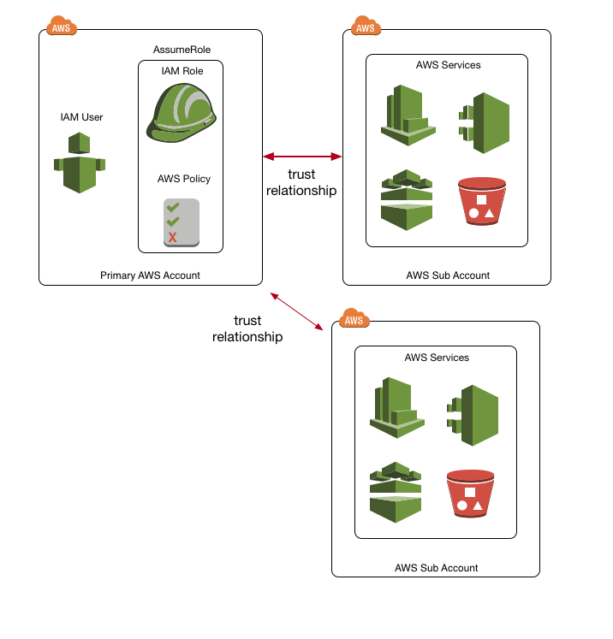
AssumeRole with IAM User
Connect main account to sub-accounts
Primary Account can collect data from sub-accounts using an AssumeRole from a trusted role
Trust Relationships must be established between the Primary Account and the sub-accounts
Notes:
Customers who have multiple accounts in AWS can setup an IAM role that has a trust relationship established between the sub-accounts that will enable it to connect to the services and collect the data into Splunk.

Slide 39
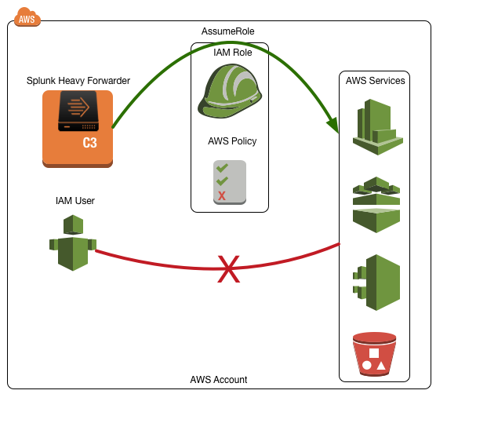
AssumeRole with EC2 Instance
Organizations with tight security controls and do not give out access keys
No direct access for IAM users or disabled AssumeRole for IAM Users
Credentials managed by assigning them to instances via IAM AssumeRole to instance
Very restrictive environment
HWF Resides in corporate VPC and can attach roles (AWS Market Place, AMI, CloudFormation Template)
Notes:
Finally, this solution is used when IAM users are not allowed to connect with AWS services either directly or indirectly using the AssumeRole functionality. In this situation, the Splunk Heavy Weight Forwarder (HWF) has an AWS role associated with it. This EC2 role can only be applied to the HWF if the customer deploys the HWF in their account with access to the EC2Role created in the earlier step.

Slide 40
Setup AWS Config
Collect Configuration changes (CMDB) from your AWS deployment
Notes:
Once we have the permissions setup, now we can concentrate on setting up AWS for Splunk to collect the data.

Slide 41
Setup AWS Config
Overview of Setup Steps
Enable AWS Config Service
Select All Resources
Setup Config Events to go to SNS topic (config-topic)
Setup S3 bucket (splunk-config-<unique_ID>)
Create AWS Config Role (config-role-<region>)
Setup Config Rules (Optional)
Create and then Subscribe SQS to newly created SNS topic (config-topic)
Create SQS Dead Letter Queue for SQS based S3 (config-dlq)
For SQS-based S3 inputs, create a “dead letter queue” called config-dlq
Assign the “dead letter queue” to the newly created config SQS
Notes:
Here are the steps that we are going to take to enable the AWS Config Service and allow Splunk to collect the data. First, log into AWS and click on Config under Management Tools. Click on the Get Started and follow the steps in the next set of slides:

Slide 42
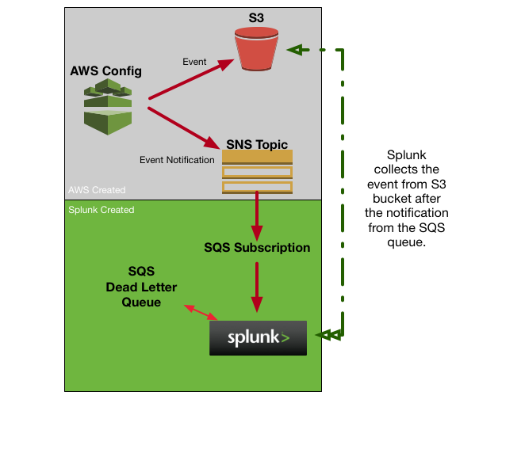
Config Data Collection Architecture Overview
Notes:
AWS Config Service will create an S3 bucket and an SNS topic which it will use to send events and event notifications respectively. In order for Splunk to collect the data, it must subscribe to an SQS which will need to be created. This ‘plumbing’ will allow Splunk to receive the notifications from AWS Config and know when to retrieve the event from the S3 bucket.

Slide 43
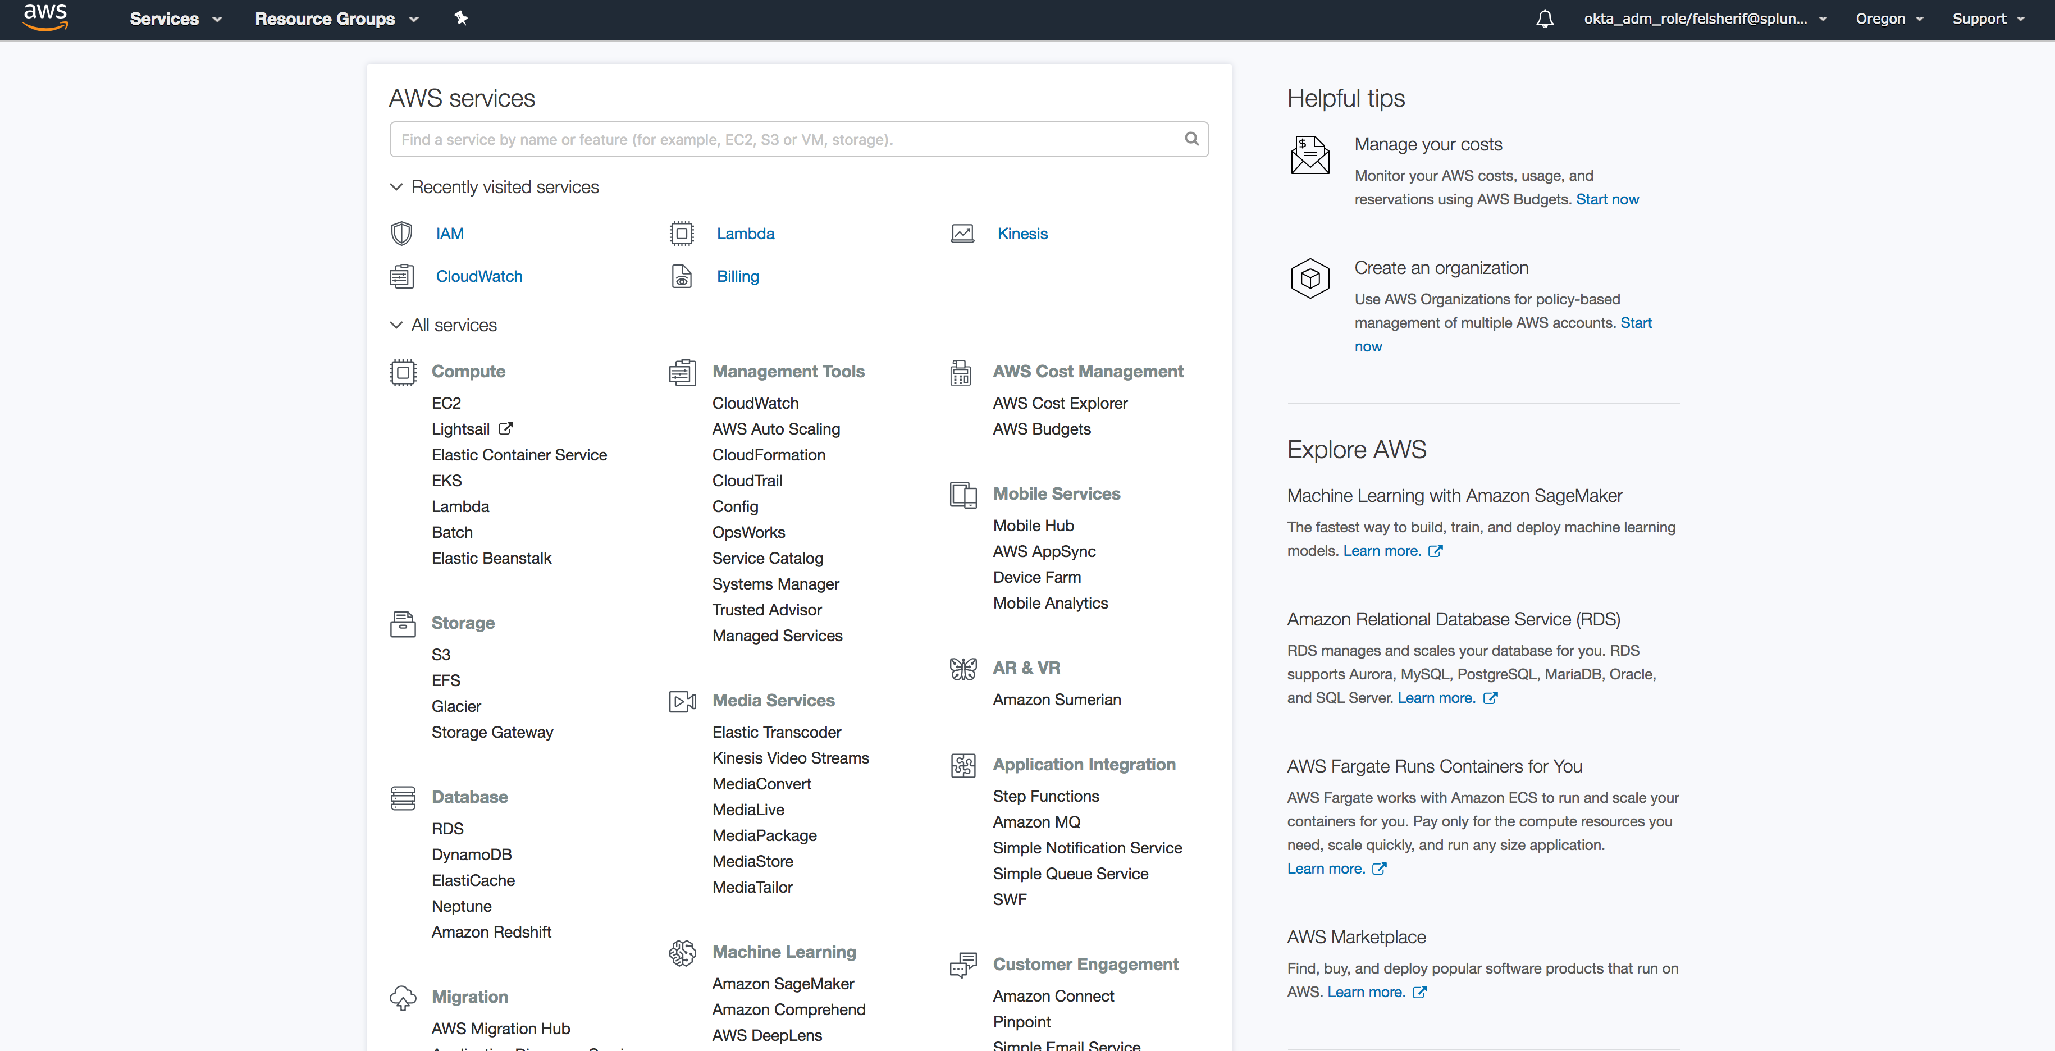
Setup AWS Config
Management Tools -> Config
Click Here
Notes:
Click on Config.

Slide 44
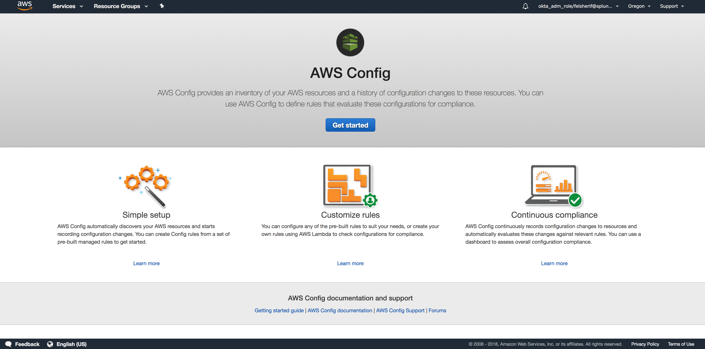
Setup AWS Config
Enable AWS Config Service
Notes:
Click on Get Started.

Slide 45
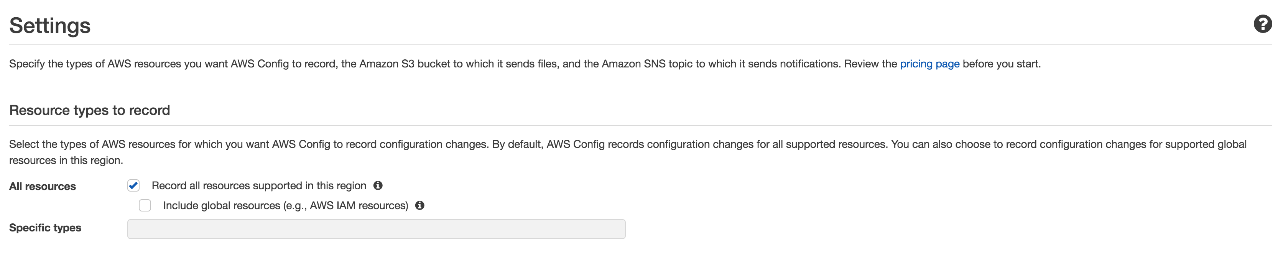
Setup AWS Config
Select All Config Resources
Notes:
Under the Config settings, make sure you keep the default settings, so keep “All resources enabled” and include global resources checked as well.

Slide 46
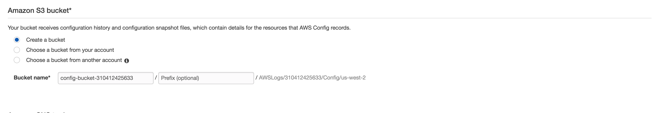
Setup AWS Config
Setup S3 Bucket
Notes:
Make sure to create an S3 bucket where your AWS config data will reside. This name has to be globaly unique, so an S3 bucket like “config” will NOT work; however using a unique name like ”config-bucket-<yourAWSAccountID>” should work.

Slide 47
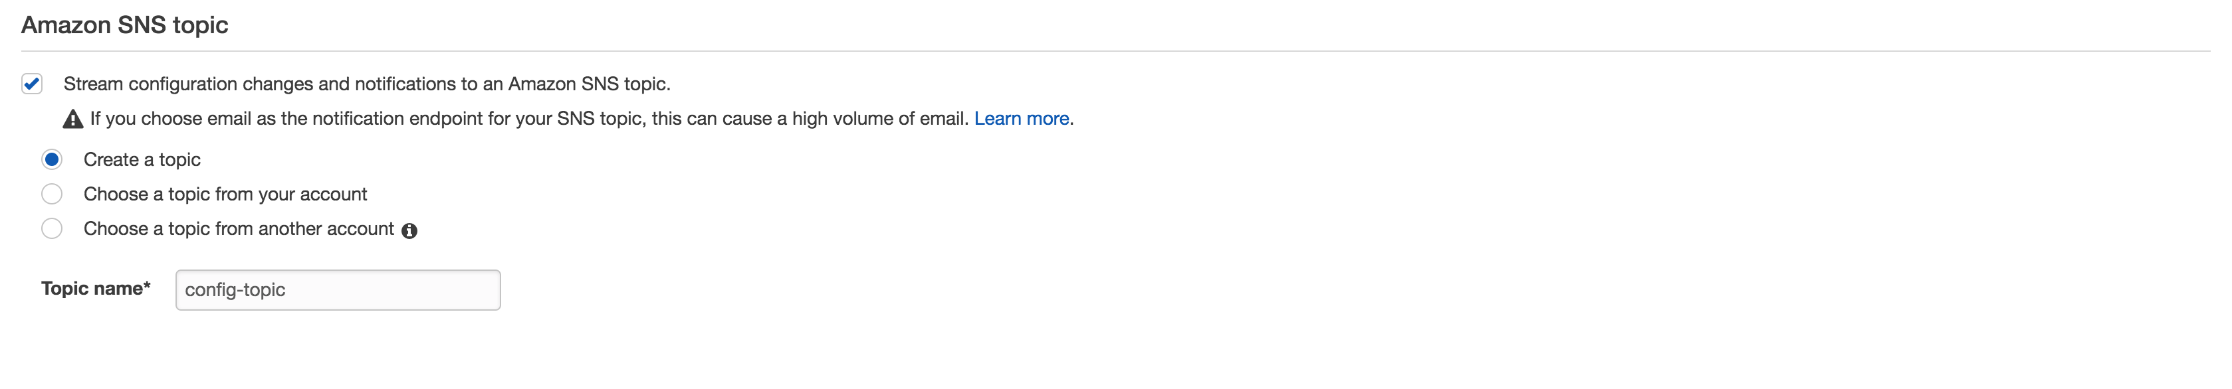
Setup AWS Config
Configure SNS Topic
Notes:
This step is very easily missed but it is critical to get the data in from config, make sure you ENABLE the Amazon SNS topic. Make sure to create a topic and name it “config-topic.”

Slide 48
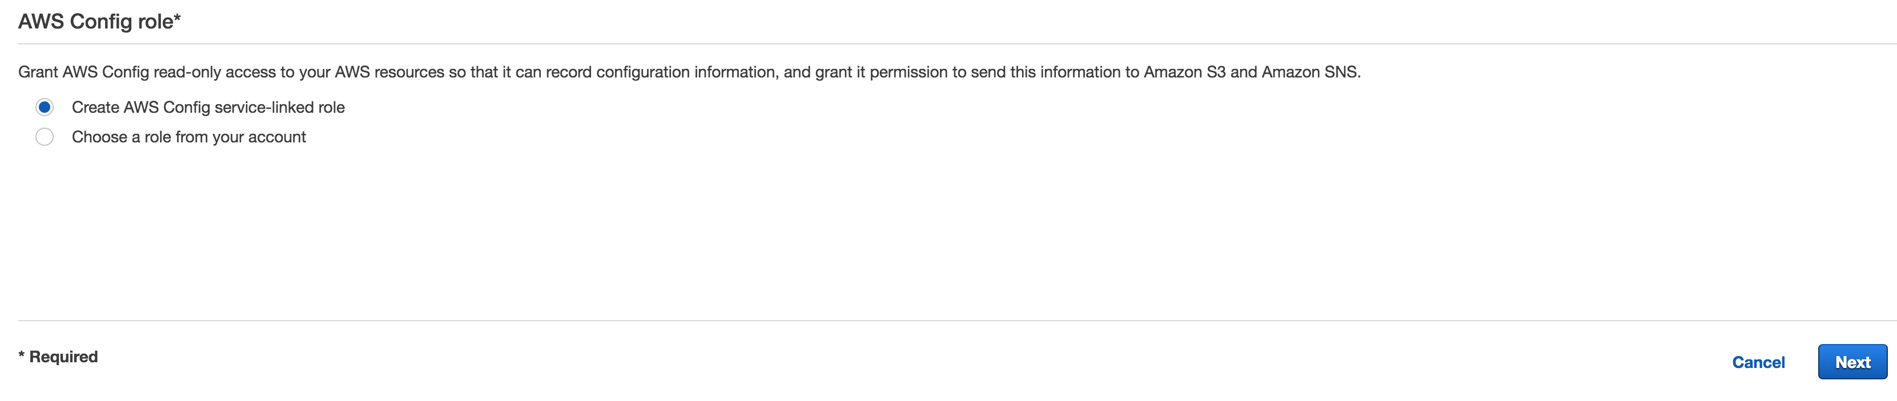
Setup AWS Config
Create AWS Config Role and Attach Policy
Notes:
Finally, create a new role to have access to all the data the AWS Config Service will generate.

Slide 49
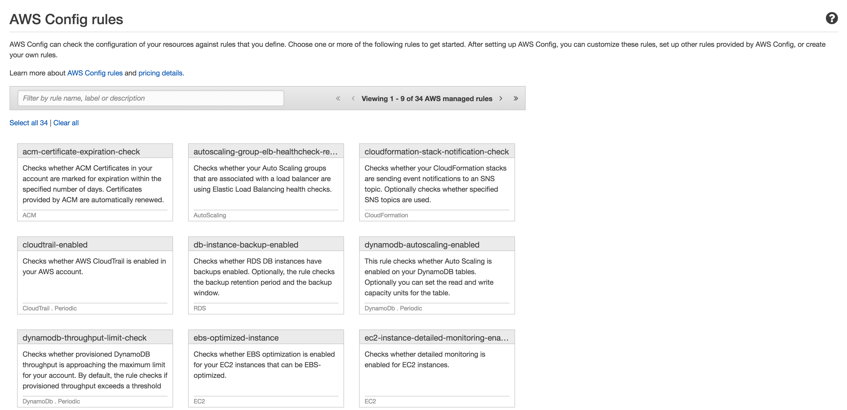
Setup AWS Config Rules
(Optional)
Notes:
There is no need to setup Config Rules for now, so just continue to the next step in setting up AWS Config.

Slide 50
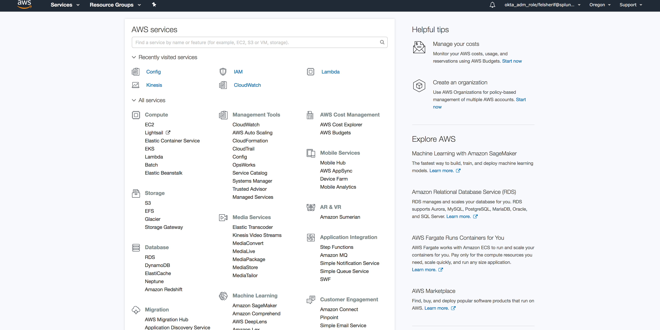
Setup SQS for Config
Click Here
Notes:
Once the AWS Config Service has been created, you will need to setup an SQS (Simple Queue Service) to subscribe to the SNS (Simple Notification Service) topic created by AWS Config. Let’s start by click on SQS under Messaging.

Slide 51
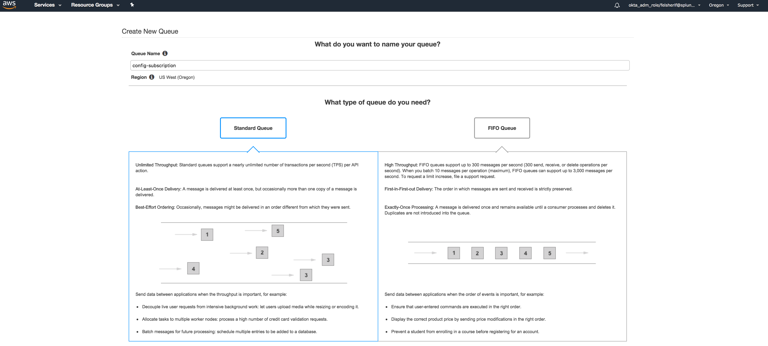
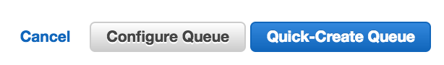
Setup AWS Config
Create SQS Queue
Notes:
Give your queue a name like “config-subscription” and click “Quick-Create Queue.”

Slide 52
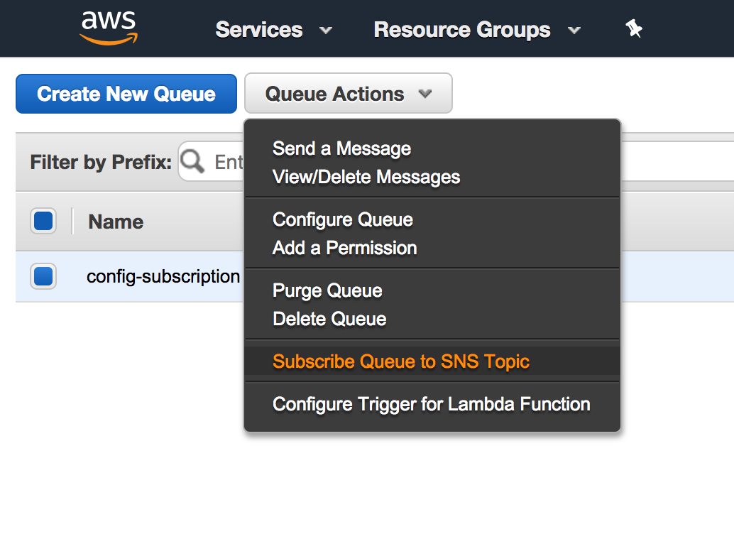
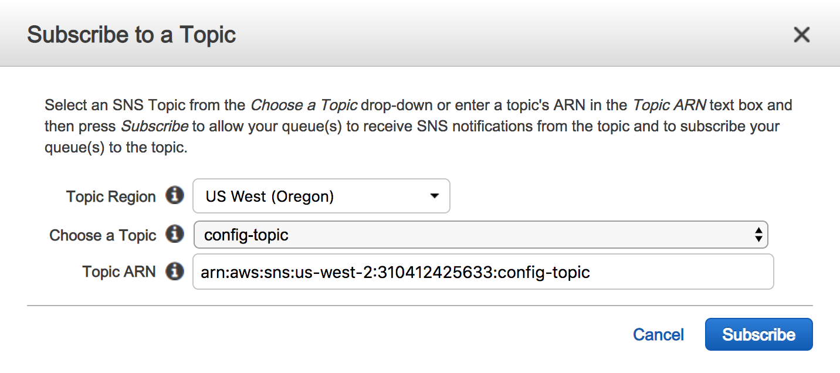
Setup AWS Config
Subscribe SQS to SNS Topic
Notes:
Once the queue has been created, select it and then click on the “Queue Actions” button and select “Subscribe to SNS Topic.” In the popup window, select the SNS topic ‘config-topic,’ and click Subscribe.

Slide 53
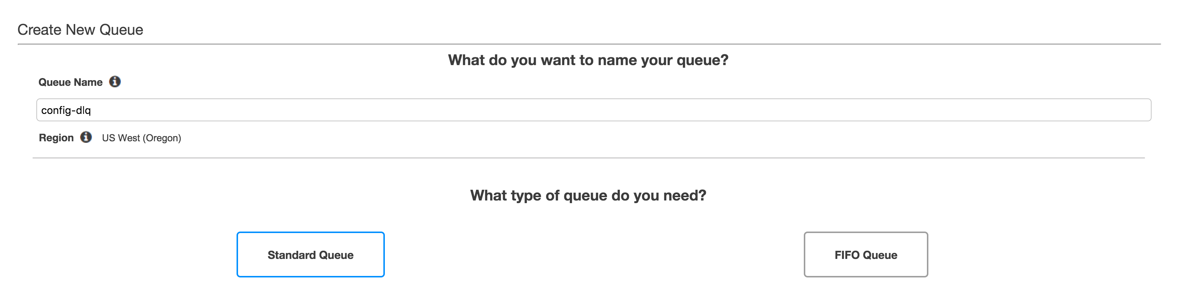
Setup AWS Config
Create dead letter queue (config-dlq)
Notes:
Click on SQS and create a new queue, call it config-dlq for Config Dead Letter Queue. This queue is required for the new Splunk SQS based S3 input. In order to keep the inputs stateless, the Dead Letter Queue will tell Splunk where the last input left off and where to continue collecting events from AWS. Once you’ve named the SQS, click on ”Quick-Create Queue.”

Slide 54
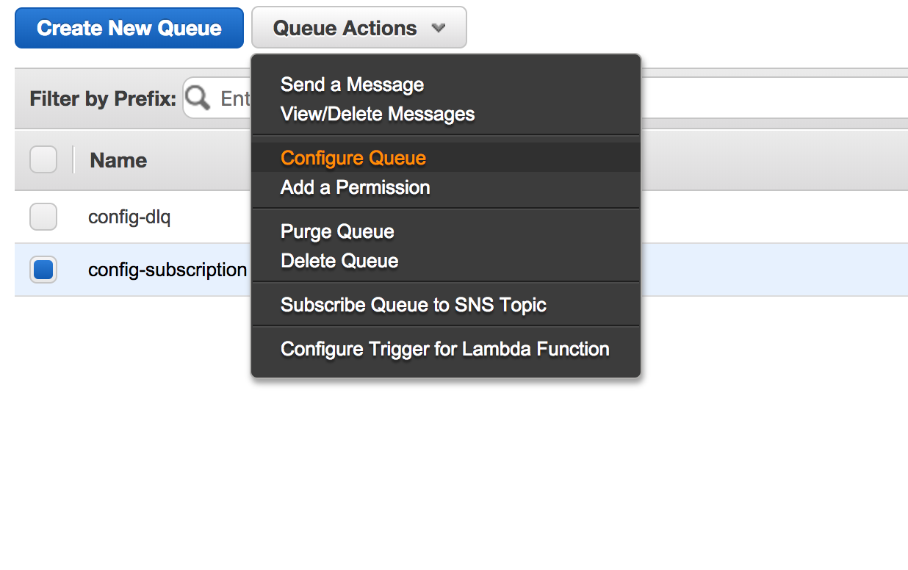
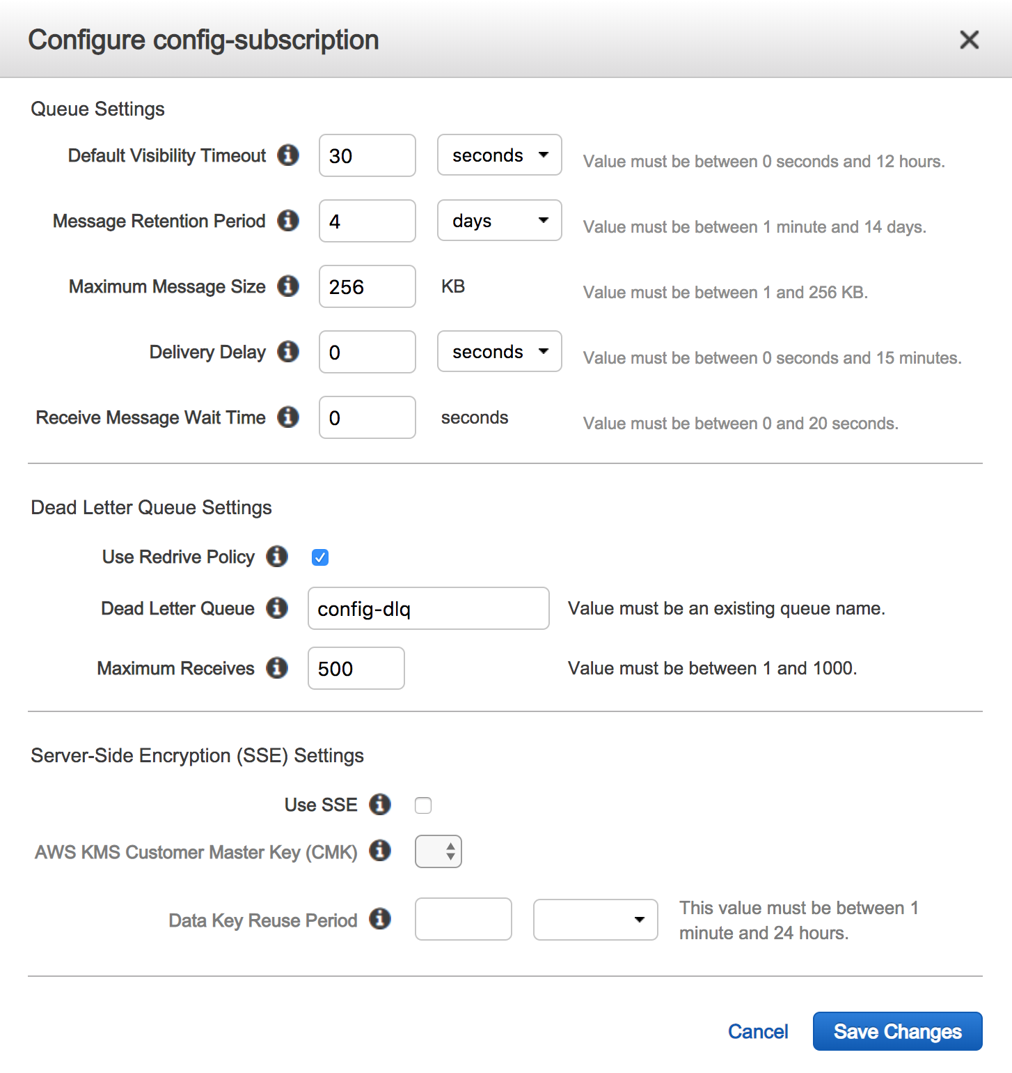
Setup AWS Config
Configure config queue to send to config-dlq (Dead Letter Queue)
Notes:
Select your “config-subscription” queue and then click on “Queue Actions” and go to Configure Queue. In the dialogue box, click on the check box by “Use Redrive Policy” and select the Dead Letter Queue you just created, config-dlq. Give the Max Receives 500 and “Save Changes.”

Slide 55
Setup AWS CloudTrail
Collect API calls from your AWS deployment

Slide 56
Setup AWS CloudTrail
Overview of Setup Steps
Enable AWS CloudTrail Service
Name CloudTrail
Setup CloudTrail Events to go to SNS topic (cloudtrail-topic)[default]
Setup S3 bucket (splunk-cloudtrail-<unique_ID>)[default]
Subscribe SQS to newly created SNS topic (cloudtrail)
For SQS-based S3 inputs, create a “dead letter queue” called cloudtrail-dlq
Assign the “dead letter queue” to the newly created cloudtrail SQS
Notes:
Here are the steps that we are going to take to enable the AWS CloudTrail Service and allow Splunk to collect the data. First, log into AWS and click on CloudTrail under Management Tools. Click on the Get Started and follow the steps in the next set of slides:

Slide 57

CloudTrail Data Collect Architecture Overview
Notes:
AWS CloudTrail Service will create an S3 bucket and an SNS topic which it will use to send events and event notifications respectively. In order for Splunk to collect the data, it must subscribe to an SQS which will need to be created. This ‘plumbing’ will allow Splunk to receive the notifications from AWS CloudTrail and know when to retrieve the event from the S3 bucket.

Slide 58

Setup AWS CloudTrail
Management Tools -> CloudTrail
Click Here
Notes:
Click on CloudTrail.

Slide 59

Setup AWS CloudTrail
Enable AWS CloudTrail Service
Notes:
Click on Get Started Now.

Slide 60

Setup AWS CloudTrail
Name CloudTrail Enable Resources / Regions
Notes:
Give your CloudTrail a name, I suggest ’cloudtrail’ and apply the trail to all regions and include all Read/Write events.

Slide 61

Setup AWS CloudTrail
Setup SNS Topic and S3 bucket
Notes:
Create a new S3 bucket, which has to be unique globally. I recommend using ‘cloudtrail-<AWSAccountID>.’ Now click on Advanced, keep all the defaults except click Yes to “Send SNS notification for every log file delivery” AND click YES to “Create a new SNS topic.” Give your SNS topic a name, again I suggest using ‘cloudtrail.’ Now click Create.

Slide 62
Setup SQS for CloudTrail
Click Here
Notes:
Once the AWS CloudTrailService has been created, you will need to setup an SQS (Simple Queue Service) to subscribe to the SNS (Simple Notification Service) topic created by AWS CloudTrail. Let’s start by click on SQS under Messaging.

Slide 63

Setup AWS CloudTrail
Create SQS queue (cloudtrail)
Notes:
Give your queue a name like “cloudtrail-subscription” and click “Quick-Create Queue.”

Slide 64


Setup AWS CloudTrail
Subscribe SNS to newly created SQS queue(cloudtrail)
Notes:
Once the queue has been created, select it and then click on the “Queue Actions” button and select “Subscribe to SNS Topic.” In the popup window, select the SNS topic ‘cloudtrail,’ and click Subscribe.

Slide 65

Setup AWS CloudTrail
Create dead letter queue (cloudtrail-dlq)
Notes:
Click on SQS and create a new queue, call it cloudtrail-dlq for CloudTrail Dead Letter Queue. This queue is required for the new Splunk SQS based S3 input. In order to keep the inputs stateless, the Dead Letter Queue will tell Splunk where the last input left off and where to continue collecting events from AWS. Once you’ve named the SQS, click on ”Quick-Create Queue.”

Slide 66


Setup AWS CloudTrail
Configure cloudtrail queue to send to cloudtrail-dlq (Dead Letter Queue)
Notes:
Select your “cloudtrail-subscription” queue and then click on “Queue Actions” and go to Configure Queue. In the dialogue box, click on the check box by “Use Redrive Policy” and select the Dead Letter Queue you just created, cloudtrail-dlq. Give the Max Receives 500 and “Save Changes.”

Slide 67
Setup AWS CloudWatch Logs
Collect VPC Flow Logs from your AWS deployment
Notes:
Now let’s go ahead and setup the CloudWatch Logs, specifically VPC Flow Logs from your deployment.

Slide 68
AWS CloudWatch Setup
CloudWatch Logs vs. CloudWatch
Setup CloudWatch Groups for your log collection
See VPC Flow Log section for creation of VPCFlow Log Group
Create Log Groups for
EC2 Agent Collector
ELB / ALB logs
Custom Application Logs
VPCFlow Logs
CloudWatch Metrics already created and enabled
Notes:
Draft : still determining if this needs to be added to the presentation. So what’s the difference between CloudWatch and CloudWatch Logs? CloudWatch are the metrics for the AWS Services, while CloudWatch Logs are large volume logs generated either by AWS or by instances. One example of CloudWatch Logs are the VPCFlow Logs.

Slide 69

Setup AWS CloudWatch Logs
Setup VPC Flow Logs
Create CloudWatch Log Group (VPCFlowLogs)
Setup IAM User / Role VPC Flow permissions
Create VPC Flow Logs
Capture all data, no filter
Create flowlogrole policy
Notes:
Setting up CloudWatch Logs will start by creating the CloudWatch Log group, then opening the VPC service and pointing the Flow Logs to the newly created CloudWatch Log group. This will require that an IAM role be created that has access to write VPC Flow data to the CloudWatch Log Group. In the next module, we will setup a Lambda function to send the data into Splunk’s HTTP Event Collector (HEC).

Slide 70

Setup AWS CloudWatch
Management Tools -> CloudWatch
Click Here
Notes:
Click on CloudWatch.

Slide 71


AWS CloudWatch Logs Setup
Create CloudWatch Log Group (VPCFlowLogs)
Notes:
Navigate to the Logs section on the left hand side. Click on Actions and “Create log group.” Give that log group a name, I suggest “VPCFlowLogs.”

Slide 72



AWS CloudWatch Logs Setup
Modify IAM Role / Add VPC Flow permissions
Edit Role
Modify Trust Relationship
Update Trust Policy
DO NOT USE THIS METHOD ANYMORE, IT IS DEPRICATED SINCE IT USES THE MODULAR INPUT TO COLELCT THE VPCFLOW LOGS. USE THE HEC & LAMBDA FUNCTION METHOD INSTEAD.
Added :
vpc-flow-logs.amazonaws.com
Notes:
This step has been deprecated since we not longer use the modular input to collect the vpcflowlogs from cloudwatch. The VPC Flow logs should be collected using the HTTP Event Collector (HEC) and a lambda function since the modular input will cause performance issues and possible API rate limits to be hit by the customer.
This step was only necessary to grant the Splunk Role the ability to read the VPC Flow logs, again not necessary anymore.

Slide 73

Go to the VPC Dashboard
Click Here
Notes:
Now, let’s go into VPC and enable the Flow logs to send data to that CloudWatch Log group. Click on VPC under Networking and Content Delivery.

Slide 74


AWS CloudWatch Logs Setup
Select your VPC
Create VPC Flog Logs
Click Here
Select Filter “All.”
DO NOT CLICK on Create Flow Log yet!
Notes:
Select your VPC, if you have multiple, just follow this step for each one. Once you have your VPC Selected, click on the “Flow Logs” tab and click “Create Flow Log.” This will prompt a wizard for setting up your VPC Flow logs. Under filter, select All. Now, continue to the next slide, DO NOT CLICK on Create Flow Log yet!

Slide 75
CloudWatch Logs vs. S3 Bucket
You can send your VPCFlow Logs to either an S3 bucket or CloudWatch Log Group
CloudWatch Log
S3 Bucket
Pro : Low latency event
Pro : Filtering can be turned on
Pro : Enable alarms within AWS
Pro : Supports Push
Cons : Cost, $.50 / GB
Pro : Lower cost
Pro : Scale across HF’s
Pro : Longer retention
Pro : Easily shared cross account
Con : High latency
Con : No filtering

Slide 76


AWS CloudWatch Logs Setup
Create the default policy ‘flowlogsRole’
Click on “Set Up Permissions” and create default VPC Flow Role “flowlogsRole”
The Policy editor will pop-up, click allow and it will create the default role “flowlogsRole” and click Allow
Notes:
If this is the first time you are creating a VPC Flow Log, make sure you click on “Set Up Permissions,” since you probably DO NOT have a role to collect the VPC Flow data. This will go to a new tab where a new role ‘flowlogsRole’ will be automatically created. Click on Allow a the bottom right hand side of the screen. Continue to the next slide.

Slide 77


AWS CloudWatch Logs Setup
Select CloudWatch Log Group, VPCFlowLogs
Select “flowlogsRole”
Select the CloudWatch Log group VPCFlowLogs.
Click Create Flow Log
Notes:
You should now see the newly created role, flowlogsRole, in the dropdown; select that role and then select the Destination Log Group VPCFlowLogs (the one we just created in the CloudWatch Logs step.) Now click on “Create Flow Log.”

Slide 78

VPCFlow Logs via S3 Bucket
Send flow logs to S3 bucket, select bucket ARN

Slide 79


Create SQS Based Events on S3 bucket
Setup the SQS queues
Create SQS queues
Create ‘vpcflow_sqs’
Create ‘vpcflow_sqs_dlq’
Configure SQS
Configure vpcflow_sqs to use the dead letter queue
Set Max Receives to 3
Select vpc dead letter queue
Set Receives to 3

Slide 80


Setup the S3 Bucket
Go to Properties in the S3 Bucket
Enable the bucket Events under Advanced Settings
For PUT events, trigger the SQS ‘vpc_flow_sqs’ and click Save

Slide 81
AWS Billing
Setup Cost and Usage Report

Slide 82

AWS Cost and Usage Report (CUR)
Setup S3 bucket with billing reports
Use this documentation : https://docs.aws.amazon.com/cur/latest/userguide/cur-s3.html
Make sure to deploy S3 bucket within your master account.

Slide 83
Summary
AWS Setup

Slide 84
Summary: AWS Setup
Summary for AWS Setup
After completing this module you should have:
IAM Admin (with MFA) and SplunkAccess Account (Programmatic Access Only)
IAM Policy for SplunkAccess
IAM Role for EC2 Instances
AWS Config Setup
AWS CloudTrail Setup
AWS CloudWatch Logs for VPCFlow Logs OR S3 Buckets
AWS Billing CUR (Cost and Usage Report)
Once the AWS environment is setup, it is ready to send data into Splunk.
Notes:
After completing the steps above, you should now have all the AWS Services sending data into S3 buckets, SNS Topics and SQS queues. You are now ready to hook up Splunk and start collecting this data!

Slide 85
Continue to Module 3:
Setup Splunk Infrastructure
Getting Started with AWS

